Slide 1

Understanding and Designing Dedicated Outdoor Air Systems (DOAS)
Short Course
Stanley A. Mumma, Ph.D., P.E.
Prof. Emeritus, Architectural Engineering
Penn State University, Univ. Park, PA
sam11@psu.edu
Web: http://doas-radiant.psu.edu

Slide 2
Presentation Outline
Quick review of current leading building HVAC system issues
Define DOAS
Explain terminal equipment choices and issues
Describe DOAS equipment choices and psychrometrics
Provide a DOAS design example
30% surplus OA, why and does it use more energy?
Explain relevance of DOE and ASHRAE Research findings
Describe field applications
Conclusions

Slide 3
Key Presentation Points
Part 1:
Problems with common VAV systems
DOAS defined
DOAS Issues
Parallel sensible terminal equipment choices
Total Energy Recovery issues and control

Slide 4
Key Presentation Points
Part 2:
Impact of building pressurization on DOAS
Impact of 30% surplus OA on DOAS
Estimating OA load—it’s not the coil load
DOE Report: DOAS ranks first
System Selection Matrix
Conclusions

Slide 5
Current HVAC System of Choice: VAV
OA
Std. VAV AHU
VAV
Space 1,
VAV w/ single air delivery path

Slide 6
Inherent Problems with VAV Systems
Poor air distribution
Poor humidity control
Poor acoustical properties
Poor use of plenum and mechanical shaft space
Serious control problems, particularly with tracking return fan systems
Poor energy transport medium: air
Poor resistance to the threat of biological and chemical terrorism
Poor and unpredictable ventilation performance

Slide 7
Poor & Unpredictable Vent’n Performance
OA_{B}=3,600 cfm
OA=?
AHU
60
% OA_{B}=?
6,000 cfm
1,500 cfm
4,500 cfm
OA=2,250? (900+1,350) No!
Eq. for OA?
OA_{req’d}=900 cfm
based on table 6-1
Z₁=900/1,500
Z₁=0.6
OA_{req’d}=1,350 cfm
Z₂=0.3
OA=3,600? No! Why not?
OA+(6,000-OA)*0.225=3,600
OA=2,903, ~30% more, but no LEED point
2,903-(900+1,350)=653
more than table 6-1 value
Where does the 653 cfm go?
Over vent=?
1,350 cfm, Unvit
Unvit ratio = 0.225
1,350/6,000

Slide 8
Can VAV Limitations Be Overcome?
DOAS ?
OA=2,250
AHU
Condition of supply air, DBT & DPT?
% OA_{B} =100
2,250 cfm
900 cfm
1,350 cfm
How is the space load handled, when 6,000 cfm required for a VAV?
OA_{req’d}=900 cfm
Z₁=1
OA_{req’d}=1,350 cfm
Z₂=1

Slide 9
DOAS Defined for This Presentation
20%-70% less OA,
than VAV
High Induction Diffuser
Cool/Dry Supply
DOAS Unit w/ Energy Recovery
Building with Sensible and Latent Cooling Decoupled
Parallel Sensible Cooling System
Pressurization

Slide 10
Key DOAS Points
100% OA delivered to each zone via its own ductwork
Flow rate generally as spec. by Std. 62.1 or greater (LEED, Latent. Ctl)
Employ TER, per Std. 90.1
Generally CV
Use to decouple space S/L loads—Dry
Rarely supply at a neutral temperature
Use HID, particularly where parallel system does not use air

Slide 11
DOAS Issues: ALL ARE IMPORTANT
Reserve capacity
EW issues, including control
SA Conditions
30% surplus OA for a LEED point
Lost air side economizer
Filtration/Terror resistance
Pressurization/floor component 62.1/unbalanced flow @ EW
Toilet Exh/recirc. Air
Direct/indirect evap. Cool
Terminal equipment—series vs. parallel

Slide 12
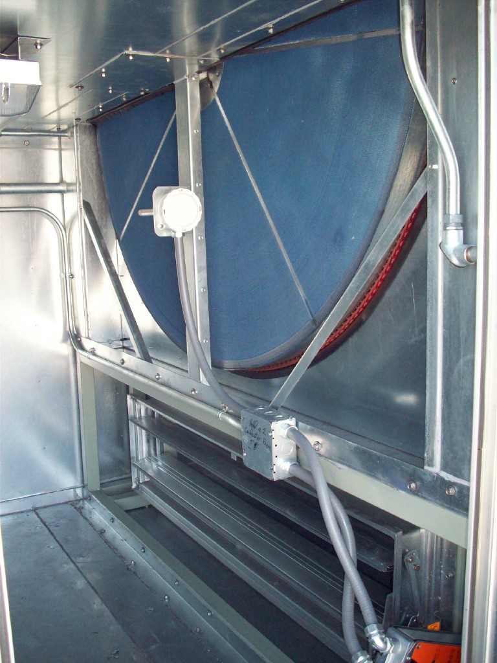
Total
Energy Recovery (TER)
Wheel

Slide 13
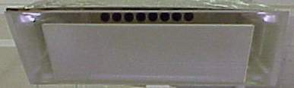
High Induction Diffuser
Provides complete air mixing
Evens temperature gradients in the space
Eliminates short-circuiting between supply & return
Increases ventilation effectiveness

Slide 14
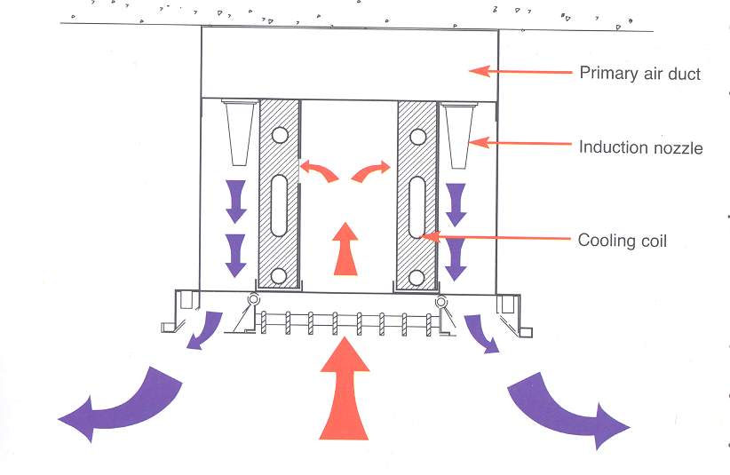
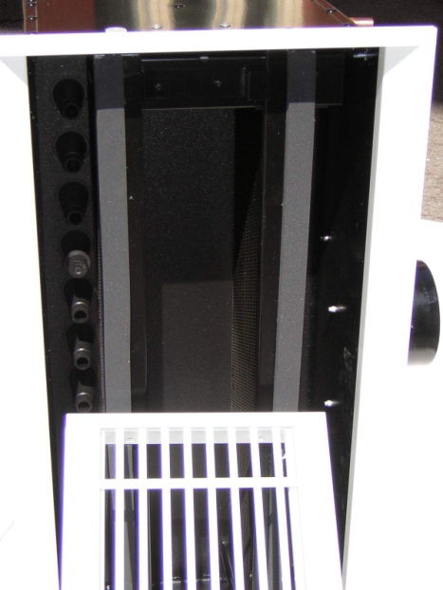
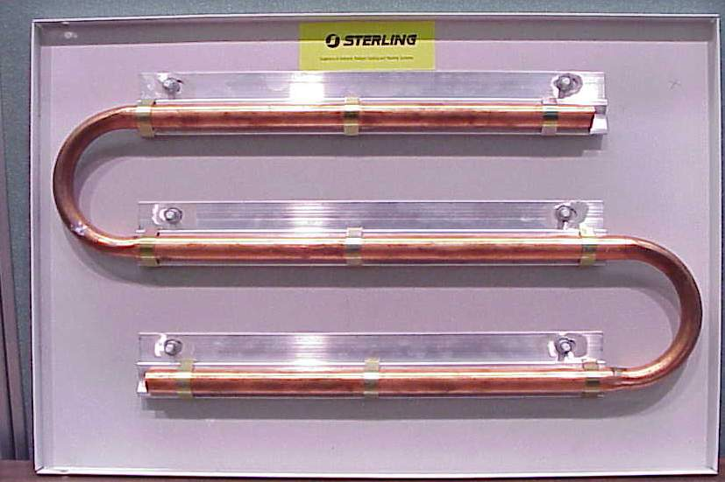

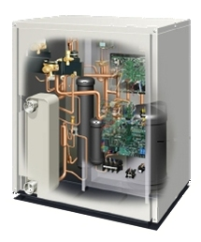
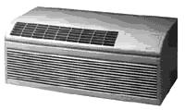
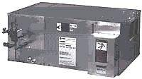
Parallel Terminal Systems
DOAS air
Induction Nozzle
Sen Cooling Coil
Radiant Cooling Panels
Room air
Chilled Beams
Fan Coil Units
Unitary ACs
i.e., WSHPs
Air Handling Units
CV or VAV
VRV
Multi-Splits
Notes:
When talking about integration of dedicated outdoor air systems with parallel terminal systems, as this symposium is based, I wanted to make it clear that we mean anything from
fan coil units,
small air handlers,
unit ventilators in schools,
or just unitary air conditioners.
But the focus of this presentation will be dedicated to radiant cooling panels.

Slide 15
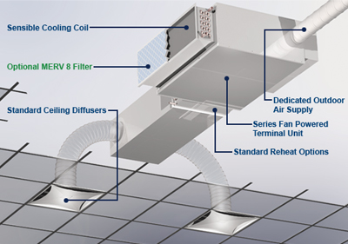

Slide 16
DOAS employing Parallel VAV
Std. VAV AHU
OA Economizer
OA
Outdoor air unit with TER
VAV
Space 2,
DOAS in
parallel w/
VAV

Slide 17
VAV Problems Solved with DOAS/Parallel VAV
Poor air distribution
Poor humidity control
Poor acoustical properties
Poor use of plenum and mechanical shaft space
Serious control problems, particularly with tracking return fan systems
Poor energy transport medium: air
Poor resistance to the threat of biological and chemical terrorism
Poor and unpredictable ventilation performance

Slide 18
DOAS employing Parallel FCU
Other ways to introduce OA at FCU? Implications?
OA
Outdoor air unit with TER
FCU
Space 3,
DOAS in parallel w/
FCU

Slide 19
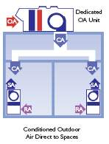
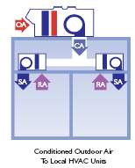
Parallel vs. Series OA Introduced for DOAS-FCU Applications?
Parallel, Good Series, Bad

Slide 20
Advantages of the Correct Paradigm Parallel FCU-DOAS Arrangement
At low sensible cooling load conditions, the terminal equipment may be shut off—saving fan energy
The terminal device fans may be down sized since they are not handling any of the ventilation air, reducing first-cost
The smaller terminal fans result in fan energy savings
The cooling coils in the terminal FCU’s are not derated since they are handling only warm return air, resulting in smaller coils and further reducing first-cost
Opportunity for plenum condensation is reduced since the ventilation air is not introduced into the plenum near the terminal equipment, for better IAQ

Slide 21
VAV Problems Solved with DOAS/Parallel FCU
Poor air distribution
Poor humidity control
Poor acoustical properties
Poor use of plenum and mechanical shaft space
Serious control problems, particularly with tracking return fan systems
Poor energy transport medium: air
Poor resistance to the threat of biological and chemical terrorism
Poor and unpredictable ventilation performance

Slide 22

DOAS employing Parallel Radiant, or Chilled Beam
OA
Outdoor air unit with TER
Radiant Panel
Space 3,
DOAS in parallel w/
CRCP

Slide 23
VAV Problems Solved with DOAS/Radiant-Chilled Beam
Poor air distribution
Poor humidity control
Poor acoustical properties
Poor use of plenum and mechanical shaft space
Serious control problems, particularly with tracking return fan systems
Poor energy transport medium: air
Poor resistance to the threat of biological and chemical terrorism
Poor and unpredictable ventilation performance

Slide 24
Additional Benefits of DOAS/Radiant-Chilled Beam
Beside solving problems that have gone unsolved for nearly 40 years with conventional VAV systems, note the following benefits:
Greater than 50% reduction in mechanical system operating cost compared to VAV
Equal or lower first cost
Simpler controls
Generates LEED certification points

Slide 25
DOA Equipment on the Market Today
I: Equipment that adds sensible energy recovery or hot gas for central reheat
II: Equipment that uses total energy recovery
III: Equipment that uses total energy recovery and passive dehumidification wheels
IV: Equipment that uses active dehumidification wheels, generally without energy recovery

Slide 26
DOAS Equipment on the Market Today
K.I.S.S. (II): H/C coils with TER
Pressurization
TER
Fan
RA
5
4
Space
1
2
3
OA
FCU
PH
CC
SA DBT, DPT to decouple space loads?

Slide 27
EW
RA
5
1
2
3
4
Space
2
OA
PH
CC
Hot & humid OA condition
3
5
4

Slide 28
DOAS unit & Energy Recovery
ASHRAE Standard 90.1 and ASHRAE’s new Standard for the Design Of High Performance Green Buildings (189.1) both require most DOAS systems to utilize exhaust air energy recovery equipment with at least 50% or 60% energy recovery effectiveness:
  that means a change in the enthalpy of the outdoor air supply equal to 50% or 60% of the difference between the outdoor air and return air enthalpies at design conditions.
Std 62.1 allows its use with class 1-3 air.

Slide 29
Climate Zone 60% TER Req’d Std. 189.1-2009 Design Air flow when >80% OA
1A, 2A, 3A, 4A, 5A, 6A, 7, 8 (Moist E. US + Alaska) > 0 cfm (all sizes require TER)
6B > 1,500 cfm
1B, 2B, 5C > 4,000 cfm
3B, 3C, 4B, 4C, 5B > 5,000 cfm

Slide 31
Hot humid OA, 2,666 hrs. EW on either method, no difference
EW should be off! 1,255 hrs. If EW on, cooling use increases by 10,500 Ton Hrs (TH).
EW should be off! 1,261 hrs. If EW on, cooling use increases 18,690 TH
EW speed to modulate to hold 48F SAT. 3,523 hrs. If EW full on, cooling use increases by 45,755 TH
EW off. 55 hrs. If on, cooling use increases 115 TH.

Slide 32
Conclusion: operating the EW in KC all the time for a 10,000 scfm OA system equipped with a 70% effective (ε) EW will consume 75,060 extra TH of cooling per year. At 1 kW/ton and $0.15/kWh—this represents $11,260 of waste, and takes us far from NZE buildings.

Slide 33
EW should be on! 1,048 hrs. If EW off, cooling use increases by 9,540 Ton Hrs (TH).
EW should be off! 72 hrs. If EW on, cooling use increases 1 TH
EW should be off. 55 hrs. If EW on, cooling use increases 115 TH.

Slide 34
+5% error in RH reading. Causes EW to be off when it should be on. 206 hours, 270 extra TH of cooling needed, costing $40.45 when cooling uses 1 kW/ton and energy costs $0.15/kWh
-5% error in RH reading. Causes EW to be on when it should be off. 34 hours, 25 extra TH of cooling needed, costing $3.80 when cooling uses 1 kW/ton and energy costs 0.15/kWh

Slide 35
If a DBT error of 1F caused the EW to operate above 76F rather than 75F, that 1F band contains 153 hours of data. It would increase the cooling load by 2,255 TH and increase the operating cost by $338 assuming 1 kW/ton cooling performance and $0.15/kWh utility cost. It would also make it impossible to down-size the cooling plant/equip!!!!

Slide 37
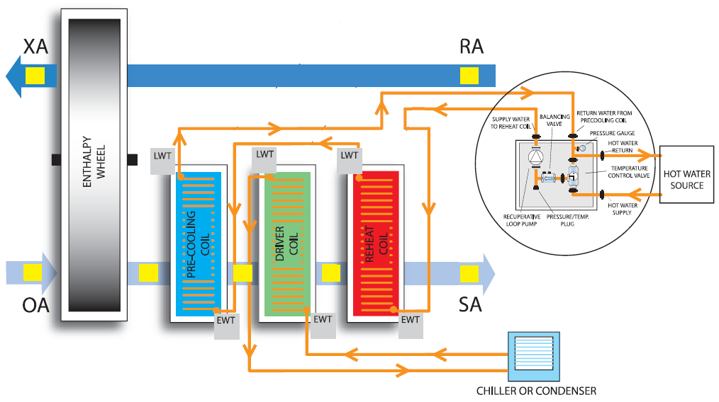
DOAS Equipment on the Market Today
7
6
1
2
3
4
5

Slide 38
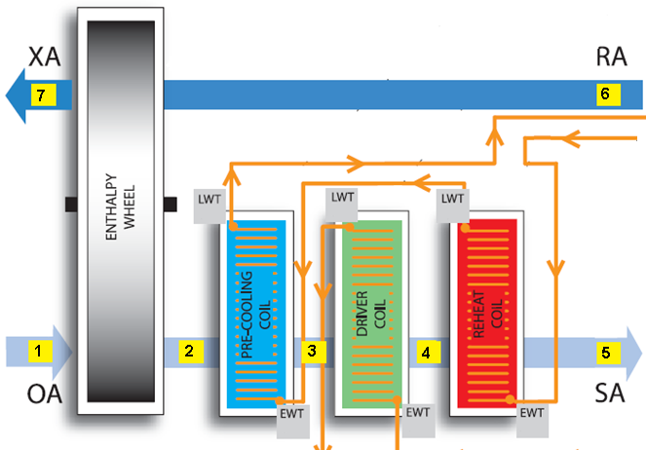
1
3
2
Hot & humid OA condition
6
4
5

Slide 39
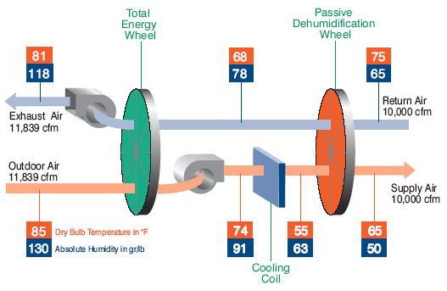
DOAS Equipment on the Market Today
Desiccant added for 3 reasons:
1. 45°F CHWS still works
2. achieve DPT < freezing
3. reduce or eliminate reheat
Type 3

Slide 40
7
6
5
1
2
3
4
1
7
2
6
Enthalpy 4 > 3
3
5
4
DOAS needs

Slide 41
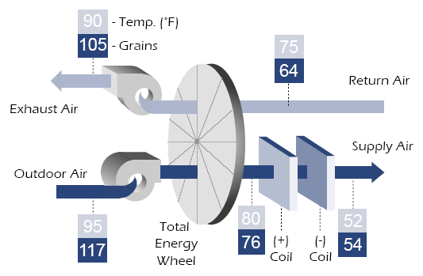
Top DOAS unit Configuration Choices

Slide 42
A Few Additional Comments
Regarding DOAS Equipment
TER Effectiveness is an important factor
TER desiccant an important choice
TER purge, pro and con
Fan energy use management
Reserve capacity must be considered: many benefits
Importance of building pressurization, and the impact on TER effectiveness when unbalanced flow exists
Smaller DOAS with a pressurization unit

Slide 43
Part 2
Impact of building pressurization on DOAS
Impact of 30% surplus OA on DOAS
Estimating OA load—it’s not the coil load
DOE Report: DOAS ranks first
System Selection Matrix
Conclusions

Slide 44
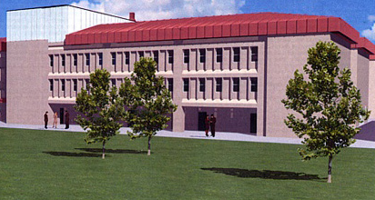


Air Flow Paths for a Typical
All-Air System
Total OA flow
per Std. 62.1
Toilet &
Bldg Exh.
Relief air
Exfiltration from Pressurization flow
+
= A
A
B
B

Slide 45
DOAS w/ Unbalanced Flow
at the TER
Relief air,
Toilet &
Bldg Exh.
Exfiltration from Pressurization flow
TER
OA

Slide 46
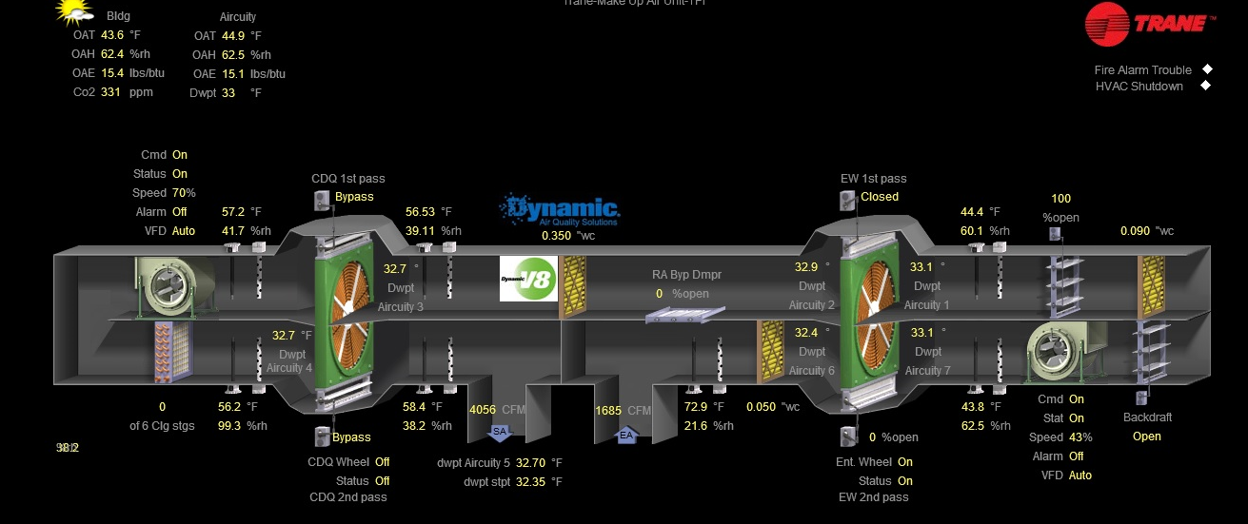
DOAS w/ Balanced Flow at
the TER + Pressurization Unit
Relief air,
Toilet &
Bldg Exh.
Exfiltration from Pressurization flow
Pressurization: 4056-1685=2371 cfm ~0.07 cfm/ft²
TER
OA

Slide 47
Unbalance @ TER if pressurization is ½ ACH, based upon Std. 62.1
Exception to std 90.1 Energy Recovery: Not req’d if exhausted airflow is less than 75% of the required OA.
What does that mean in light of pressurization?

Slide 48
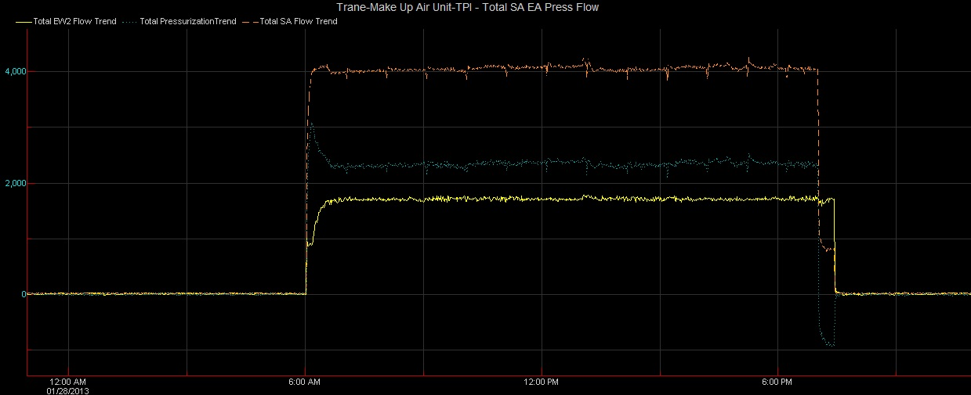
Only 40% of supply is returned to EW,
i.e. highly unbalanced flow

Slide 49
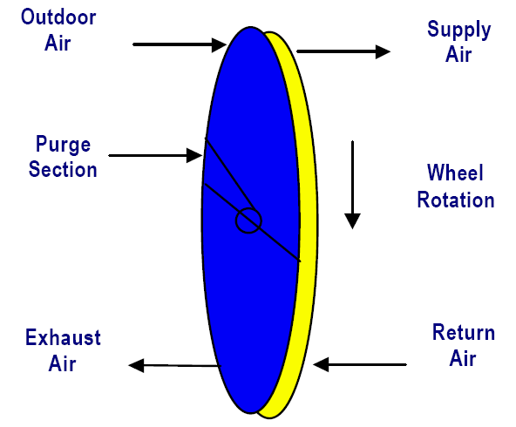
For unbalanced flow, m_{OA}= m_{RA} + m_{Pressurization}
Outdoor air
0 scfm Purge
or seal leakage
Exhaust air
h_{OA}
h_{SA}
Supply air
Wheel Rotation
Return air, including toilet exhaust
m_{OA}
h_{EA}
h_{RA}
m_{RA}
ε = m_{OA}(h_{OA}-h_{SA})/m_{RA}(h_{OA}-h_{RA}) = (h_{EA}-h_{RA})/(h_{OA}-h_{RA})
ε_{apparent} = ε∗m_{RA}/m_{OA} = (h_{OA}-h_{SA})/ (h_{OA}-h_{RA})

Slide 50
Recovered MBH based upon an 85F 140 gr OA condition, an 75F 50% RA condition, and a 130” Dia EW (519 sfpm FV OA stream)
Balanced Lecture Conf. rm Educ. Office

Slide 52
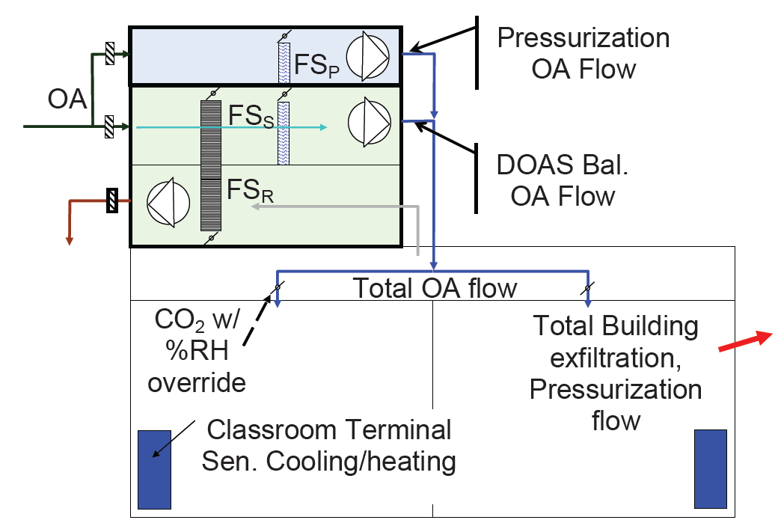
Integrated DOAS-
Pressurization Units.
Phys & Functionally

Slide 53
Leadership in Energy and Environmental Design

Slide 54
Sustainable site | 26 | 24%
H₂O η | 10 | 9%
Energy & Atmos. | 35 | 32%
Mat’ls & Resource | 14 | 13%
IEQ | 15 | 14%
Innovation | 6 | 5%
Regional Priority | 4 | 4
Max points | 110
Gold: 60-79 points
IE Q Credit 2: Increased Ventilation: 1 Point
Intent
To provide additional outdoor air ventilation to improve indoor air quality (IAQ) and promote occupant comfort, well-being and productivity.
Requirements
CASE 1. Mechanically Ventilated Spaces
Increase breathing zone outdoor air ventilation rates to occupied spaces by at least 30% above the minimum
rates required by ASHRAE Standard 62.1 (with errata but without addenda1) as determined by IEQ
Prerequisite 1: Minimum Indoor Air Quality Performance.
Is this a good reason for
30% surplus ventilation air?

Slide 55
30% Surplus Air Questioned!

Slide 56
Calculating the OA load:
Very important to get correct!
AHU
h_{OA}
h_{SA}
m_{OA}
m_{SA}= m_{OA}
900 cfm
1,350 cfm
1: Q_{OA1}=m_{OA}*(h_{OA}-h_{SA})
75F
50% RH
75F
50% RH
2: Q_{OA2}=m_{OA}*(h_{OA} -h_{relief})
Q_{Bldg}=m_{SA}*(h_{relief}-h_{SA})=Q_{OA1}-Q_{OA2}
h_{Relief}
So, Q_{OA2} is correct: Q_{OA1}=Q_{OAcorrect}+Q_{Bldg}= coil load

Slide 57
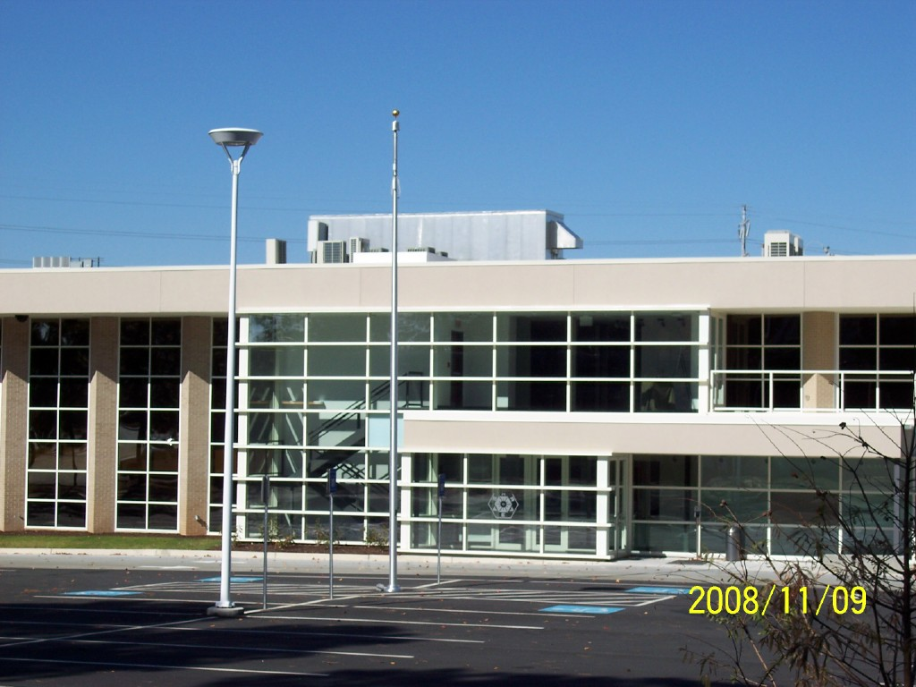
ASHRAE uses 30%
surplus OA.
And at least one
notable past
president thought
it was a bad idea!
ASHRAE HQ, Atlanta, GA

Slide 58
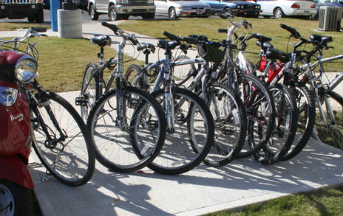
Limits of LEED authority
Is it rational to increase the ventilation air flow rate beyond 62.1? Many think not.
Can LEED be ignored? Yes
To date there is no mandate in LEED, or the law, to garner this point, and many may in fact choose to garner a LEED point by the much simpler installation of a bicycle rack.

Slide 59
Why Question 30% Surplus OA?
First Consider a Standard VAV System
OA
CC
HC
Fan
Economizer
IEQ
AHU 1st cost
Chiller 1st cost
Boiler 1st cost
Elec. Serv to bldg 1st cost
Conclusion? Energy/Env
Std. VAV AHU
RH Allowed by std 90.1?
VAV
Space 1,
VAV w/ single air delivery path

Slide 60
Why Question 30% Surplus OA?
Consider DOAS
CC
HC
Fan
Economizer
IEQ
AHU 1st cost
Chiller 1st cost
Boiler 1st cost
Elec. Serv to bldg 1st cost
Conclusion? (1st, op, LCC, env)
EW
RA
5
1
2
3
4
Space
OA
PH
CC

Slide 61
How does the 62.1 flow impact DOAS design—w/ space latent load decoupled?
Key reason to overventilate!
Elevate SA DPT.
 | Occ. Category | cfm/p | SA DPT ⁰F | 1.3*cfm/p | SA DPT ⁰F
A | Conf. rm | 6.2 | 24.84 | 8.06 | 34.75
B | Lec. cl | 8.42 | 35.9 | 10.96 | 41.63
C | Elem. cl | 11.71 | 42.75 | 15.23 | 46.08
D | Office | 17 | 47.18 | 22.1 | 49.2
E | Museum | 9 | 31.05 | 11.7 | 38.56
?

Slide 62
Required SA DPT vs. cfm/person
4%
D’
 | Occ. Category
A | Conf. rm
B | Lec. cl
C | Elem. cl
D | Office
E | Museum
D
C’
Knee of curve around 18 cfm/person
8%
C
B’
16%
E’
Increasing the latent load (200 to 250 Btu/hr-p) for a given SA flow rate, requires a lower SA DPT.
B
A’
40%
E
A

Slide 63
S.S. CO₂ PPM vs. cfm/person
Assumes an OA CO₂ conc. of 400 PPM & an occupant CO₂ gen. rate of 0.31 L/min.
Note: CO₂ conc. is a measure of dilution, i.e. IEQ
Knee of curves
~18 cfm/p
i.e. increased cfm/p yields minimal returns

Slide 64
30% Surplus Conclusion
These 3 hypotheses confirmed:
  A TER device substantially reduces the summer cooling energy used to treat OA.
  30% surplus air is quite beneficial in the winter at reducing the cooling plant energy use.
  The winter savings offsets the added cooling energy use during the warm months for Atlanta, New Orleans, Columbus OH, and Int’l Falls.

Slide 65
30% Surplus Conclusion
Increasing the ventilation air to spaces with low OA cfm/person yields big dividends in terms of allowing the SA DPT to be elevated while still accommodating all of the occupant latent loads.
I.e., if a space combined minimum OA/person is ~ 18 cfm/person, do not increase the OA. But for spaces with the 6 to 18 cfm/person range, increase those values upward close to 18 cfm/person.
Then step back and assess how close the entire building ventilation has approached a total 30% increase.

Slide 66
30% Surplus Conclusion
If, after equalizing the flow rate per person to about 18 cfm, the 30% surplus ventilation has been achieved, take the LEED point.
Note, if achieved, the LEED point is simply a by-product of elevating the SA DPT.
Otherwise abandon the goal of gaining a LEED point by this method (time to consider the bike rack?!:)—but don’t reduce the cfm/person!!!!

Slide 67
30% Surplus Conclusion
Increasing the OA flow rate beyond 18 cfm/person yields diminishing returns in terms of increasing the required SA DPT or enhanced IEQ achievement.

Slide 68
DOE Report: Ranking of DOAS and Parallel Radiant Cooling
Energy Consumption Characteristics of Commercial Building HVAC Systems: Volume III, Energy Savings Potential
Available at:
http://doas-radiant.psu.edu/DOE_report.pdf

Slide 69
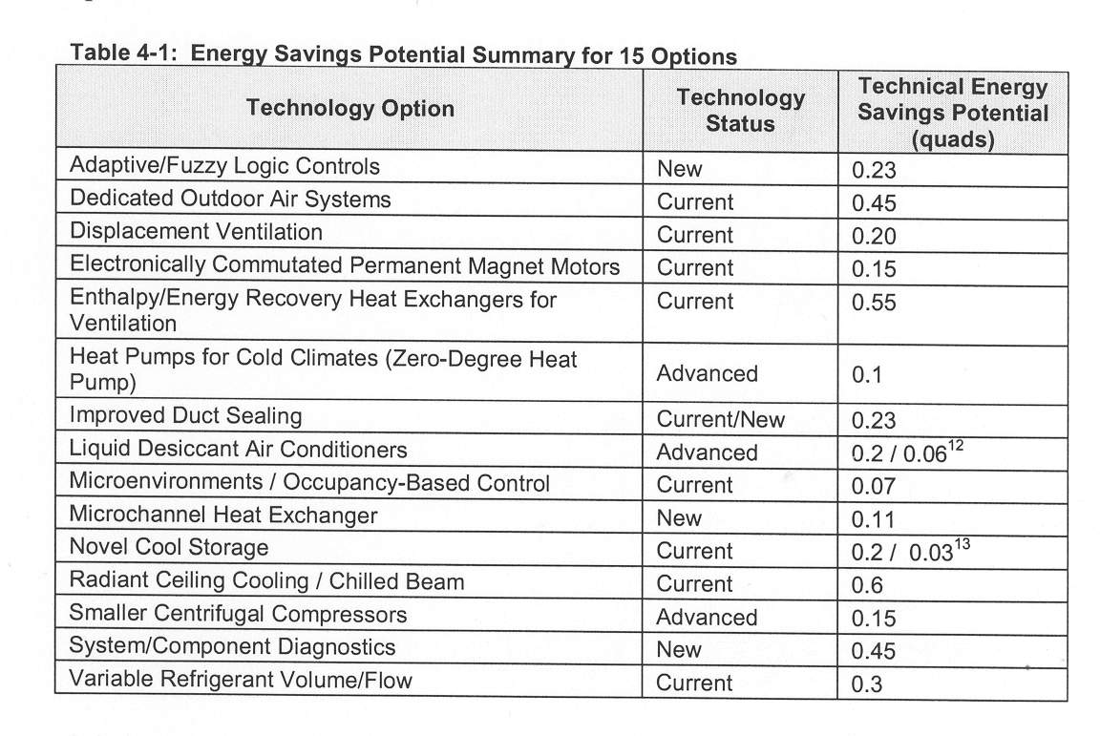
#3
#2
#1
#3

Slide 70
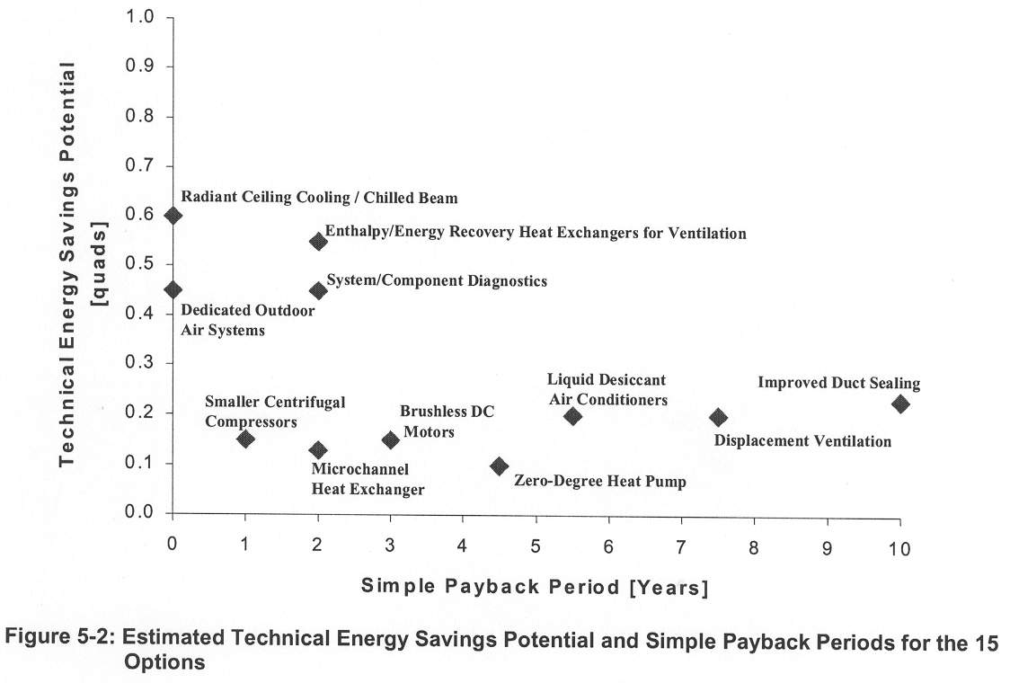
Both DOAS and Radiant Have Instant Paybacks

Slide 71
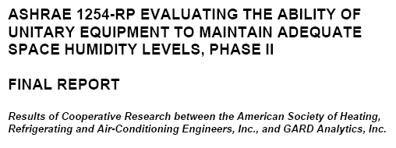
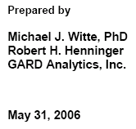
What Has ASHRAE-Sponsored Research Found?
censored
Office: 1 story 6,600 ft²
Retail: 1 story 79,000 ft²

Slide 72
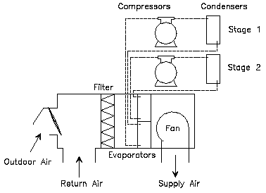
Base Case: DX, 350 cfm/ton

Slide 73
DX (400 cfm/ton) with Desiccant

Slide 74
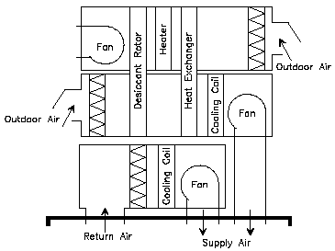
DOAS w/ Desiccant + DX
350 cfm/ton
400 cfm/ton

Slide 75
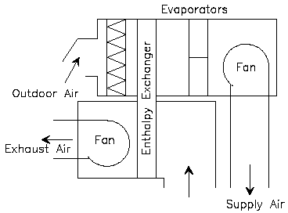
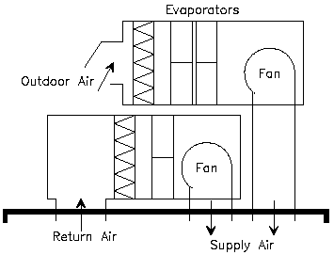
DOAS w/ EW + DX
350 cfm/ton
CC
400 cfm/ton
CC

Slide 76
Performance for Office, Based upon 62.1-2004 Ventilation Req’d
Humidity Control (Occ. Hours >65% RH)
Location | Miami | Hous | Shrev | Ft. Wor | Atlant | DC | St. Lo | NY | Chic | Port
DX w/ Desiccant | 0 | 0 | 0 | 0 | 0 | 0 | 0 | 0 | 0 | 0
DOAS w/ Des. +DX | 0 | 0 | 0 | 0 | 0 | 0 | 0 | 0 | 0 | 0
DOAS w/ EW +DX | 0 | 0 | 0 | 0 | 0 | 0 | 0 | 0 | 0 | 0
Annual Op Cost vs. Base DX
DX w/ Desiccant | 52% | 23 | 18 | 12 | 9 | 1 | -2 | 1 | -8 | -1
DOAS w/ Des. +DX | 48% | 18 | 14 | 8 | 8 | -3 | -5 | -6 | -14 | -8
DOAS w/ EW +DX | -18% | -21 | -20 | -19 | -19 | -23 | -26 | -19 | -26 | -14
LCC: Equipment 1st + 15 yr Gas and Electric $, 1,000’s 2004 dollars
Base DX | 37 | 37 | 36 | 40 | 35 | 40 | 38 | 55 | 40 | 35
DOAS w/ Des. +DX | 54 | 48 | 46 | 48 | 44 | 47 | 45 | 63 | 45 | 42
DOAS w/ EW +DX | 35 | 35 | 33 | 37 | 33 | 37 | 35 | 52 | 37 | 36

Slide 77
Performance for Retail, Based upon 62.1-2004 Ventilation Req’d
Humidity Control (Occ. Hours >65% RH)
Location | Miami | Hous | Shrev | Ft. Wor | Atlant | DC | St. Lo | NY | Chic | Port
DX w/ Desiccant | 0 | 0 | 0 | 0 | 0 | 0 | 0 | 0 | 0 | 0
DOAS w/ Des. +DX | 0 | 0 | 0 | 0 | 0 | 0 | 0 | 0 | 0 | 0
DOAS w/ EW +DX | 0 | 1 | 6 | 0 | 0 | 0 | 0 | 0 | 0 | 0
Annual Op Cost vs. Base DX (%)
DX w/ Desiccant | 169 | 79 | 75 | 47 | 61 | 18 | 14 | 6 | -11 | -2
DOAS w/ Des. +DX | 137 | 53 | 44 | 20 | 20 | -9 | -11 | -14 | -30 | -15
DOAS w/ EW +DX | -39 | -42 | -41 | -42 | -41 | -51 | -54 | -44 | -55 | -28
LCC: Equipment 1st + 15 yr Gas and Electric $, 1,000’s 2004 dollars
Base DX | 505 | 544 | 522 | 565 | 484 | 606 | 577 | 784 | 610 | 471
DOAS w/ Des. +DX | 999 | 889 | 820 | 799 | 712 | 753 | 739 | 965 | 710 | 633
DOAS w/ EW +DX | 405 | 404 | 387 | 406 | 387 | 423 | 401 | 595 | 433 | 431

Slide 78
Do Other DOAS-Radiant Systems Currently Exist—in the US?
Let’s look briefly at one

Slide 79
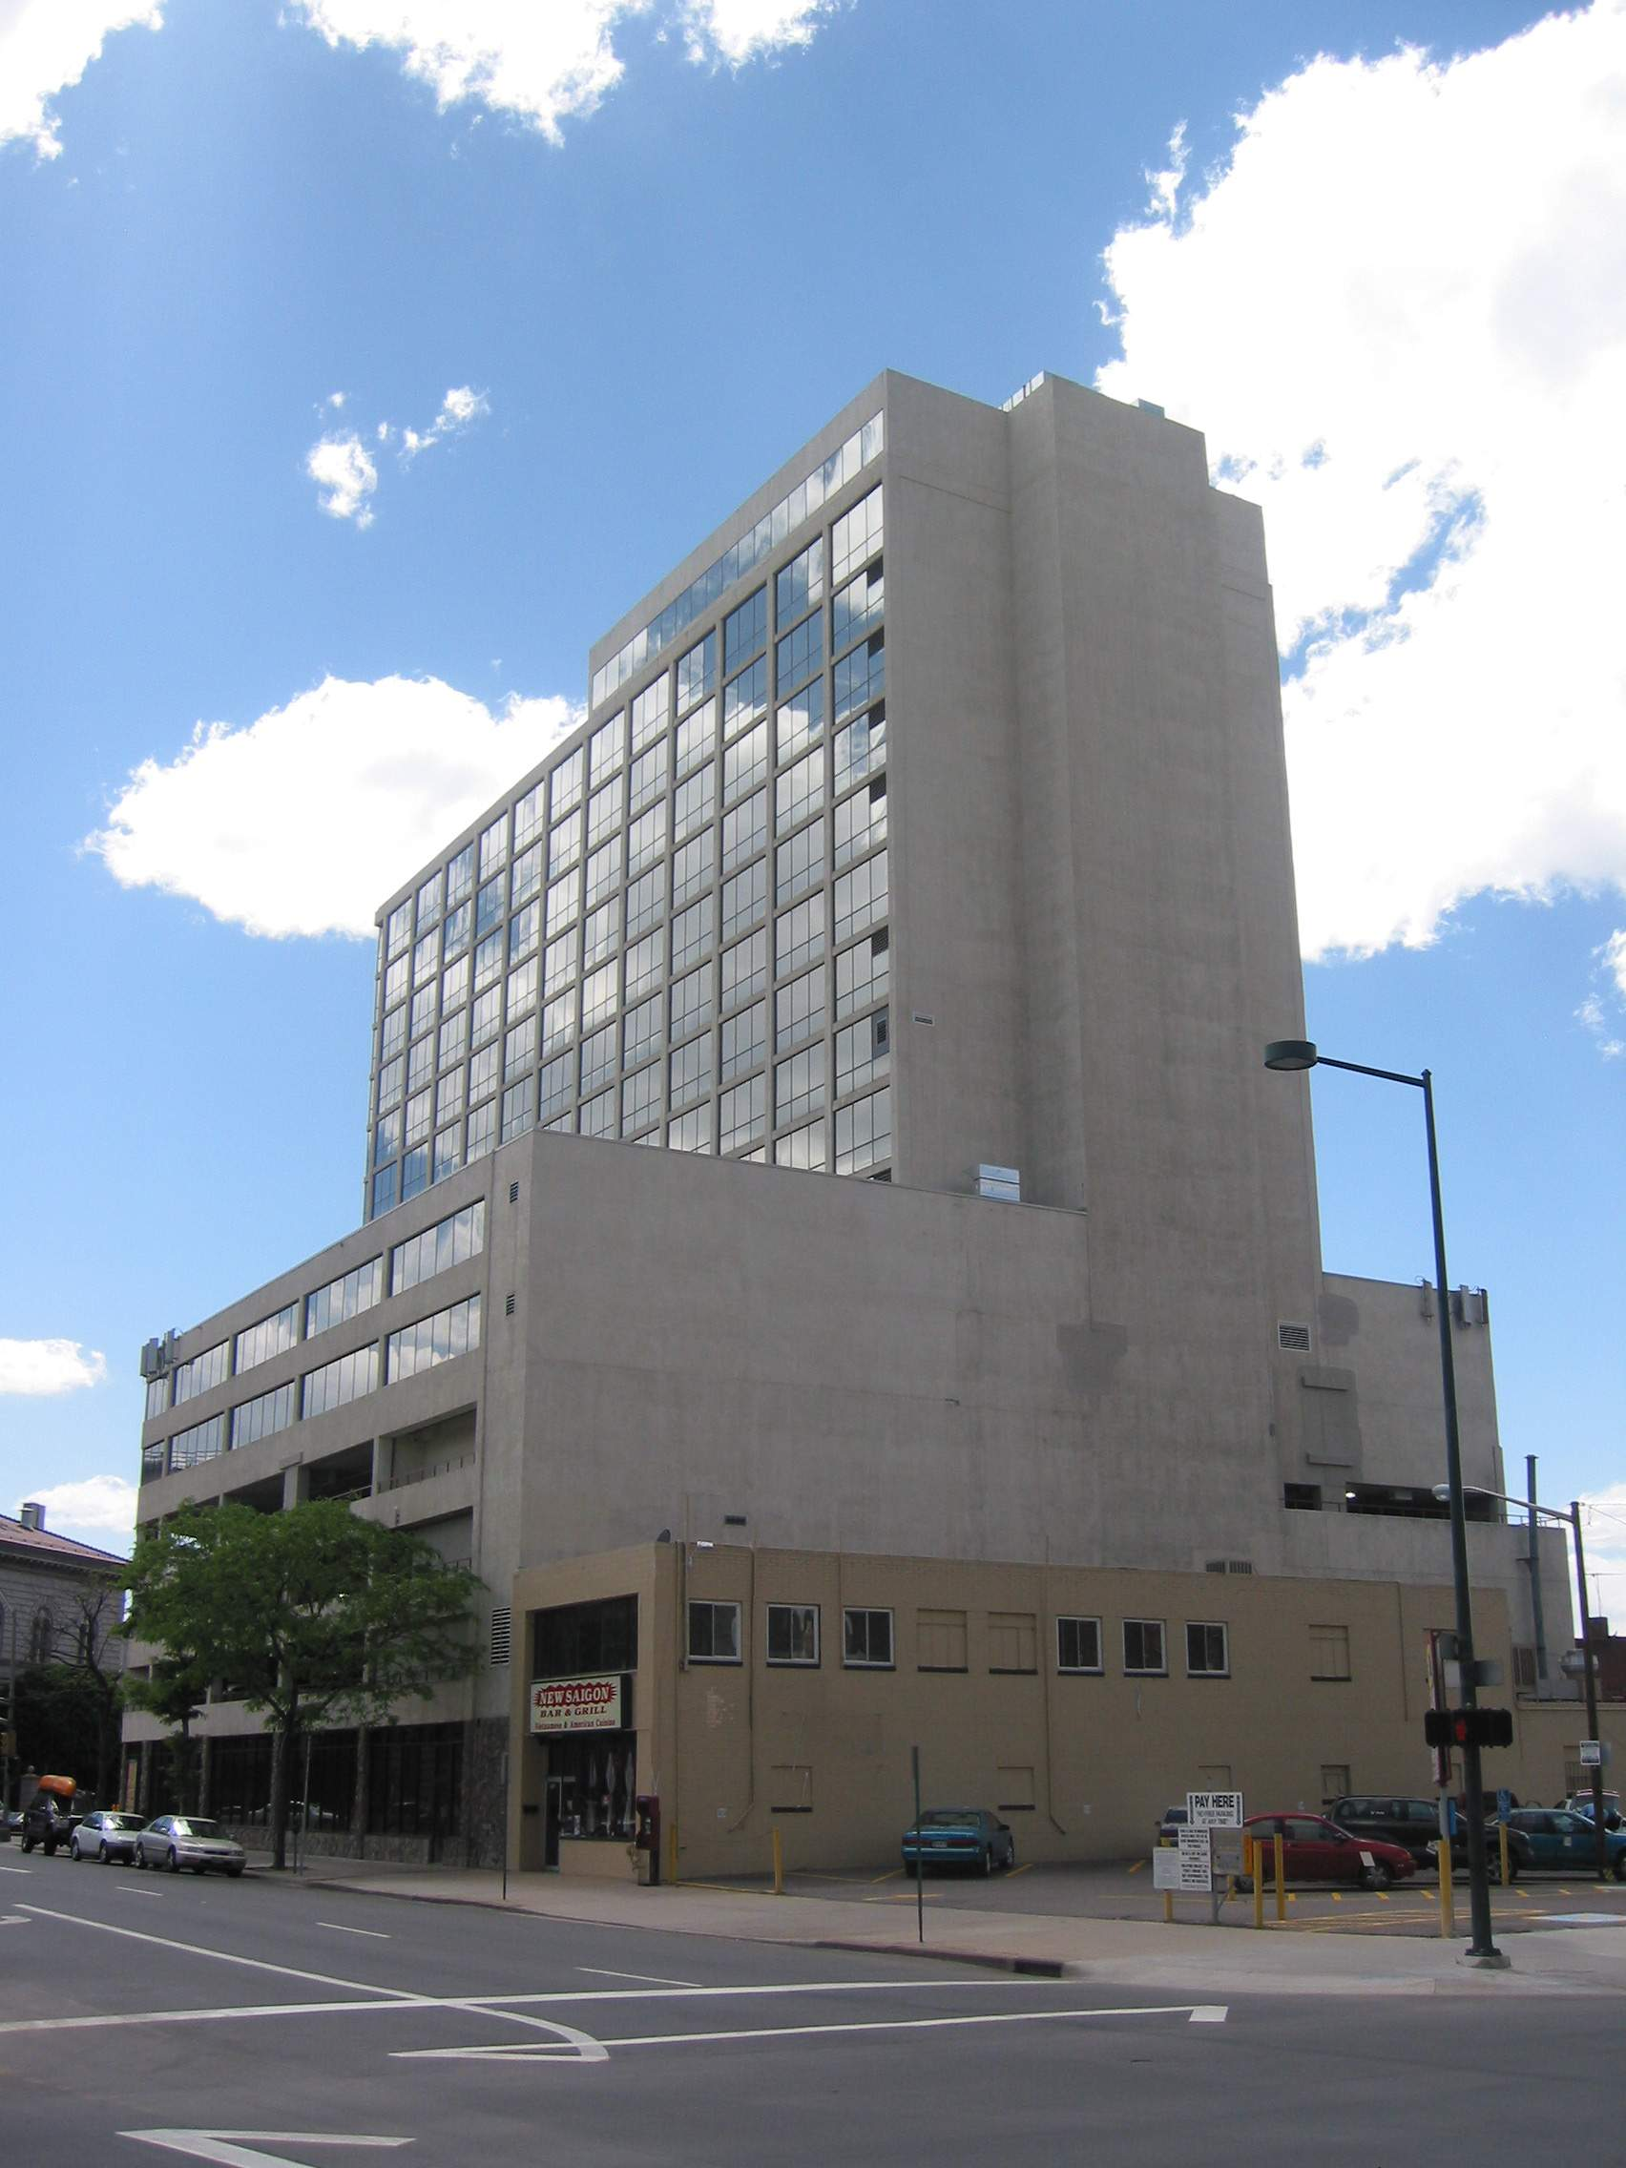
ASHRAE tour site:
Denver summer meeting
Municipal Building, Denver

Slide 80
Max points, 272: VAV 53%, DOAS-Rad 90%
Sys. Alts | IAQ (5) (wtg) | 1st $ (5) | Op. $ (4) | DBT Ctl. (3) | Plenum depth (5) | AHU (1) | Future Flex (4) | Maint (3) | Ductwork (2) | Noise (2) | Total Score
FCU w/ DOAS | 5/25 | 7/35 | 1/4 | 1/3 | 6/30 | 8/8 | 1/4 | 1/3 | 6/12 | 1/2 | 126
VAV, HW RH | 4/20 | 5/25 | 3/12 | 5/15 | 2/12 | 4/4 | 5/20 | 7/21 | 2/4 | 7/14 | 145
LT VAV, HW RH | 4/20 | 6/30 | 4/16 | 6/18 | 3/30 | 4/4 | 6/24 | 7/21 | 3/6 | 7/14 | 183
FPVAV, HW RH | 2/10 | 4/20 | 5/20 | 4/12 | 4/20 | 8/8 | 3/12 | 3/9 | 4/8 | 2/4 | 123
FPVAV, Chw recool | 1/5 | 3/15 | 6/24 | 3/9 | 5/25 | 8/8 | 4/16 | 2/6 | 7/14 | 3/6 | 128
LT DDVAV | 3/15 | 2/10 | 2/8 | 2/6 | 1/5 | 4/4 | 2/8 | 4/12 | 1/2 | 5/10 | 80
UFAD | 6/30 | 1/5 | 7/28 | 8/24 | 8/40 | 4/4 | 8/32 | 5/15 | 8/16 | 4/8 | 202
CRCP-DOAS | 8/40 | 8/40 | 8/32 | 7/21 | 7/35 | 8/8 | 7/28 | 8/24 | 5/10 | 8/16 | 254
Category Feature rating/score
System performance in a category (i.e. 1st cost) rating 1-8 (8 Best): i.e. FCUw/ DOAS meeting 1st cost earns a 7
Importance weighting of a category 1-5 (5 most important)
Score: in a cell: product of importance weighting and system performance. i.e. for CRCP-DOAS in the category of Op $, the score is 4*8=32
Conventional VAV 145 pts: DOAS-Rad 254 pts

Slide 81
A Few Other DOAS Applications

Slide 82
ASHRAE HQ, Atlanta, GA
DOAS unit

Slide 83
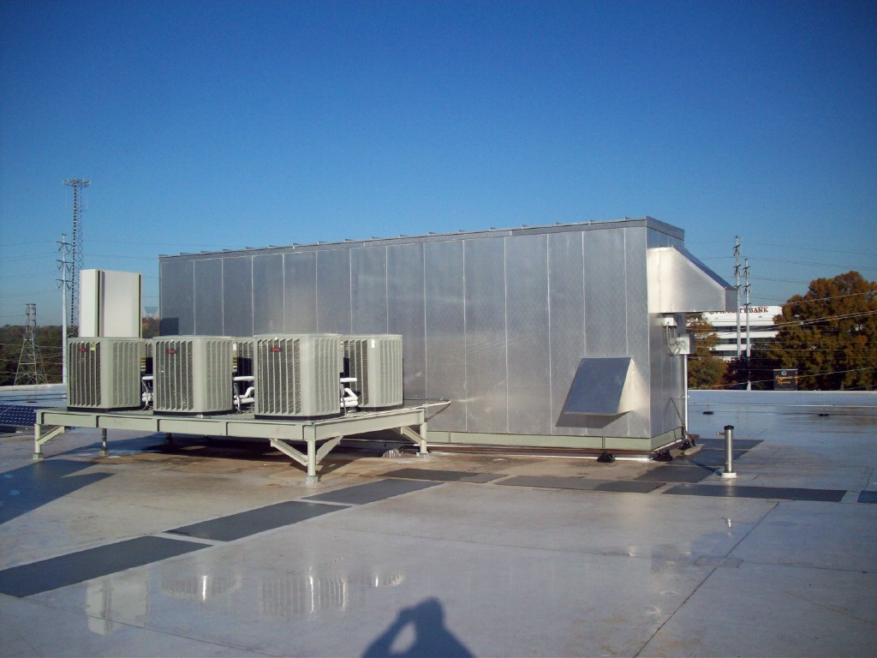
ASHRAE HDQ DOAS unit
VRV Outdoor Units

Slide 84
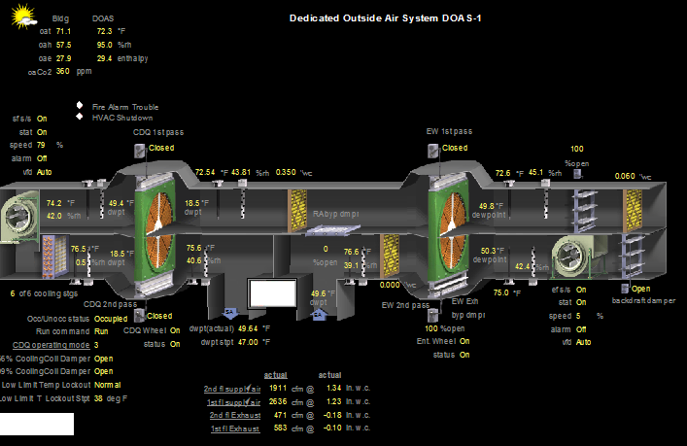
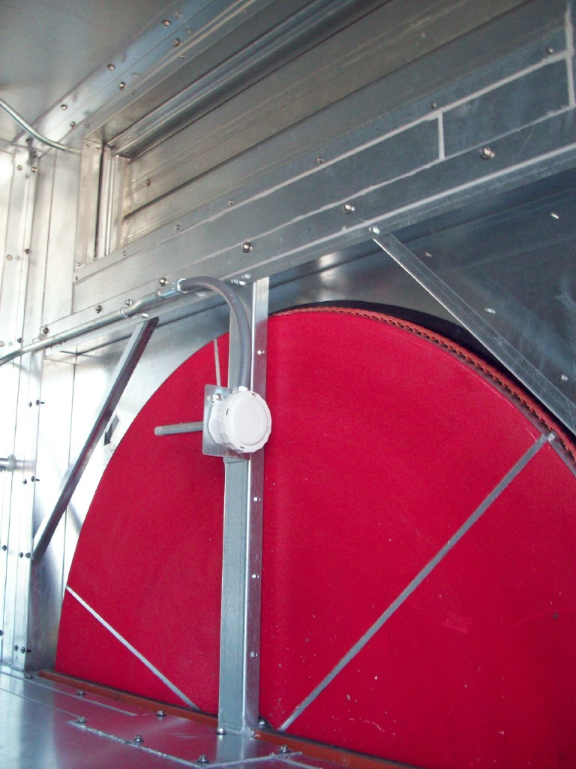
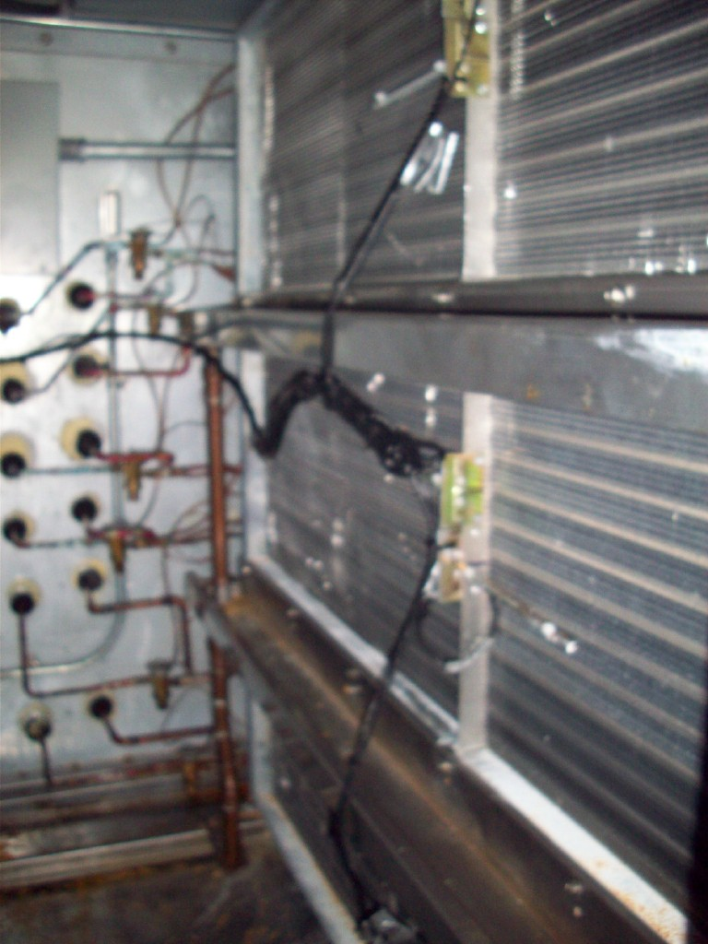

Slide 85
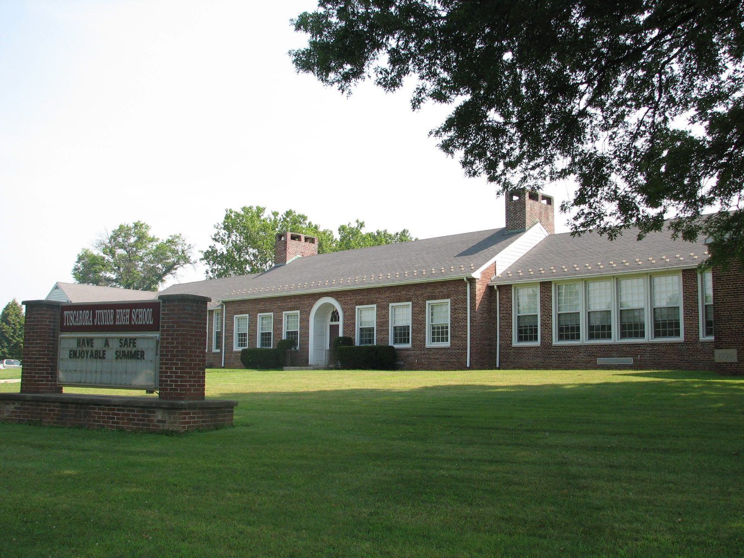
Middle School w/ DOAS

Slide 86

Air Cooled DX DOAS unit

Slide 87
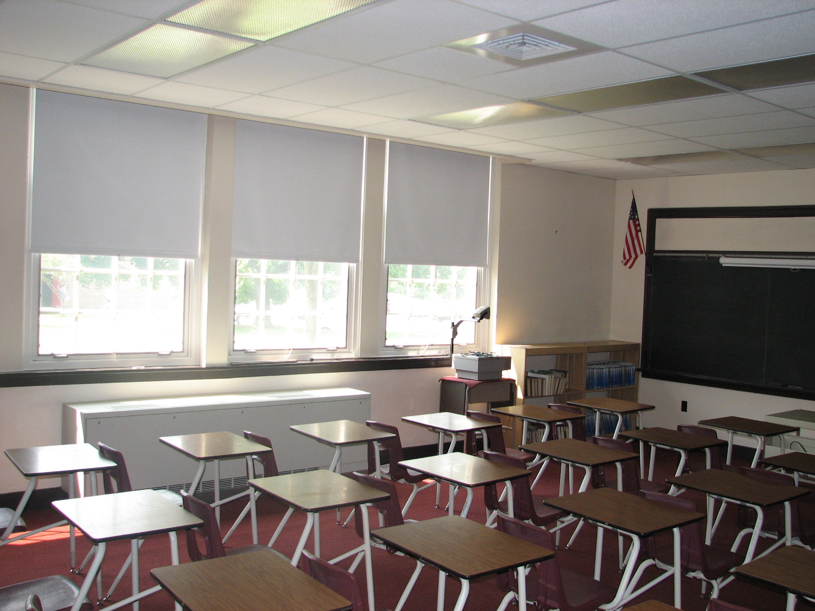

Slide 88
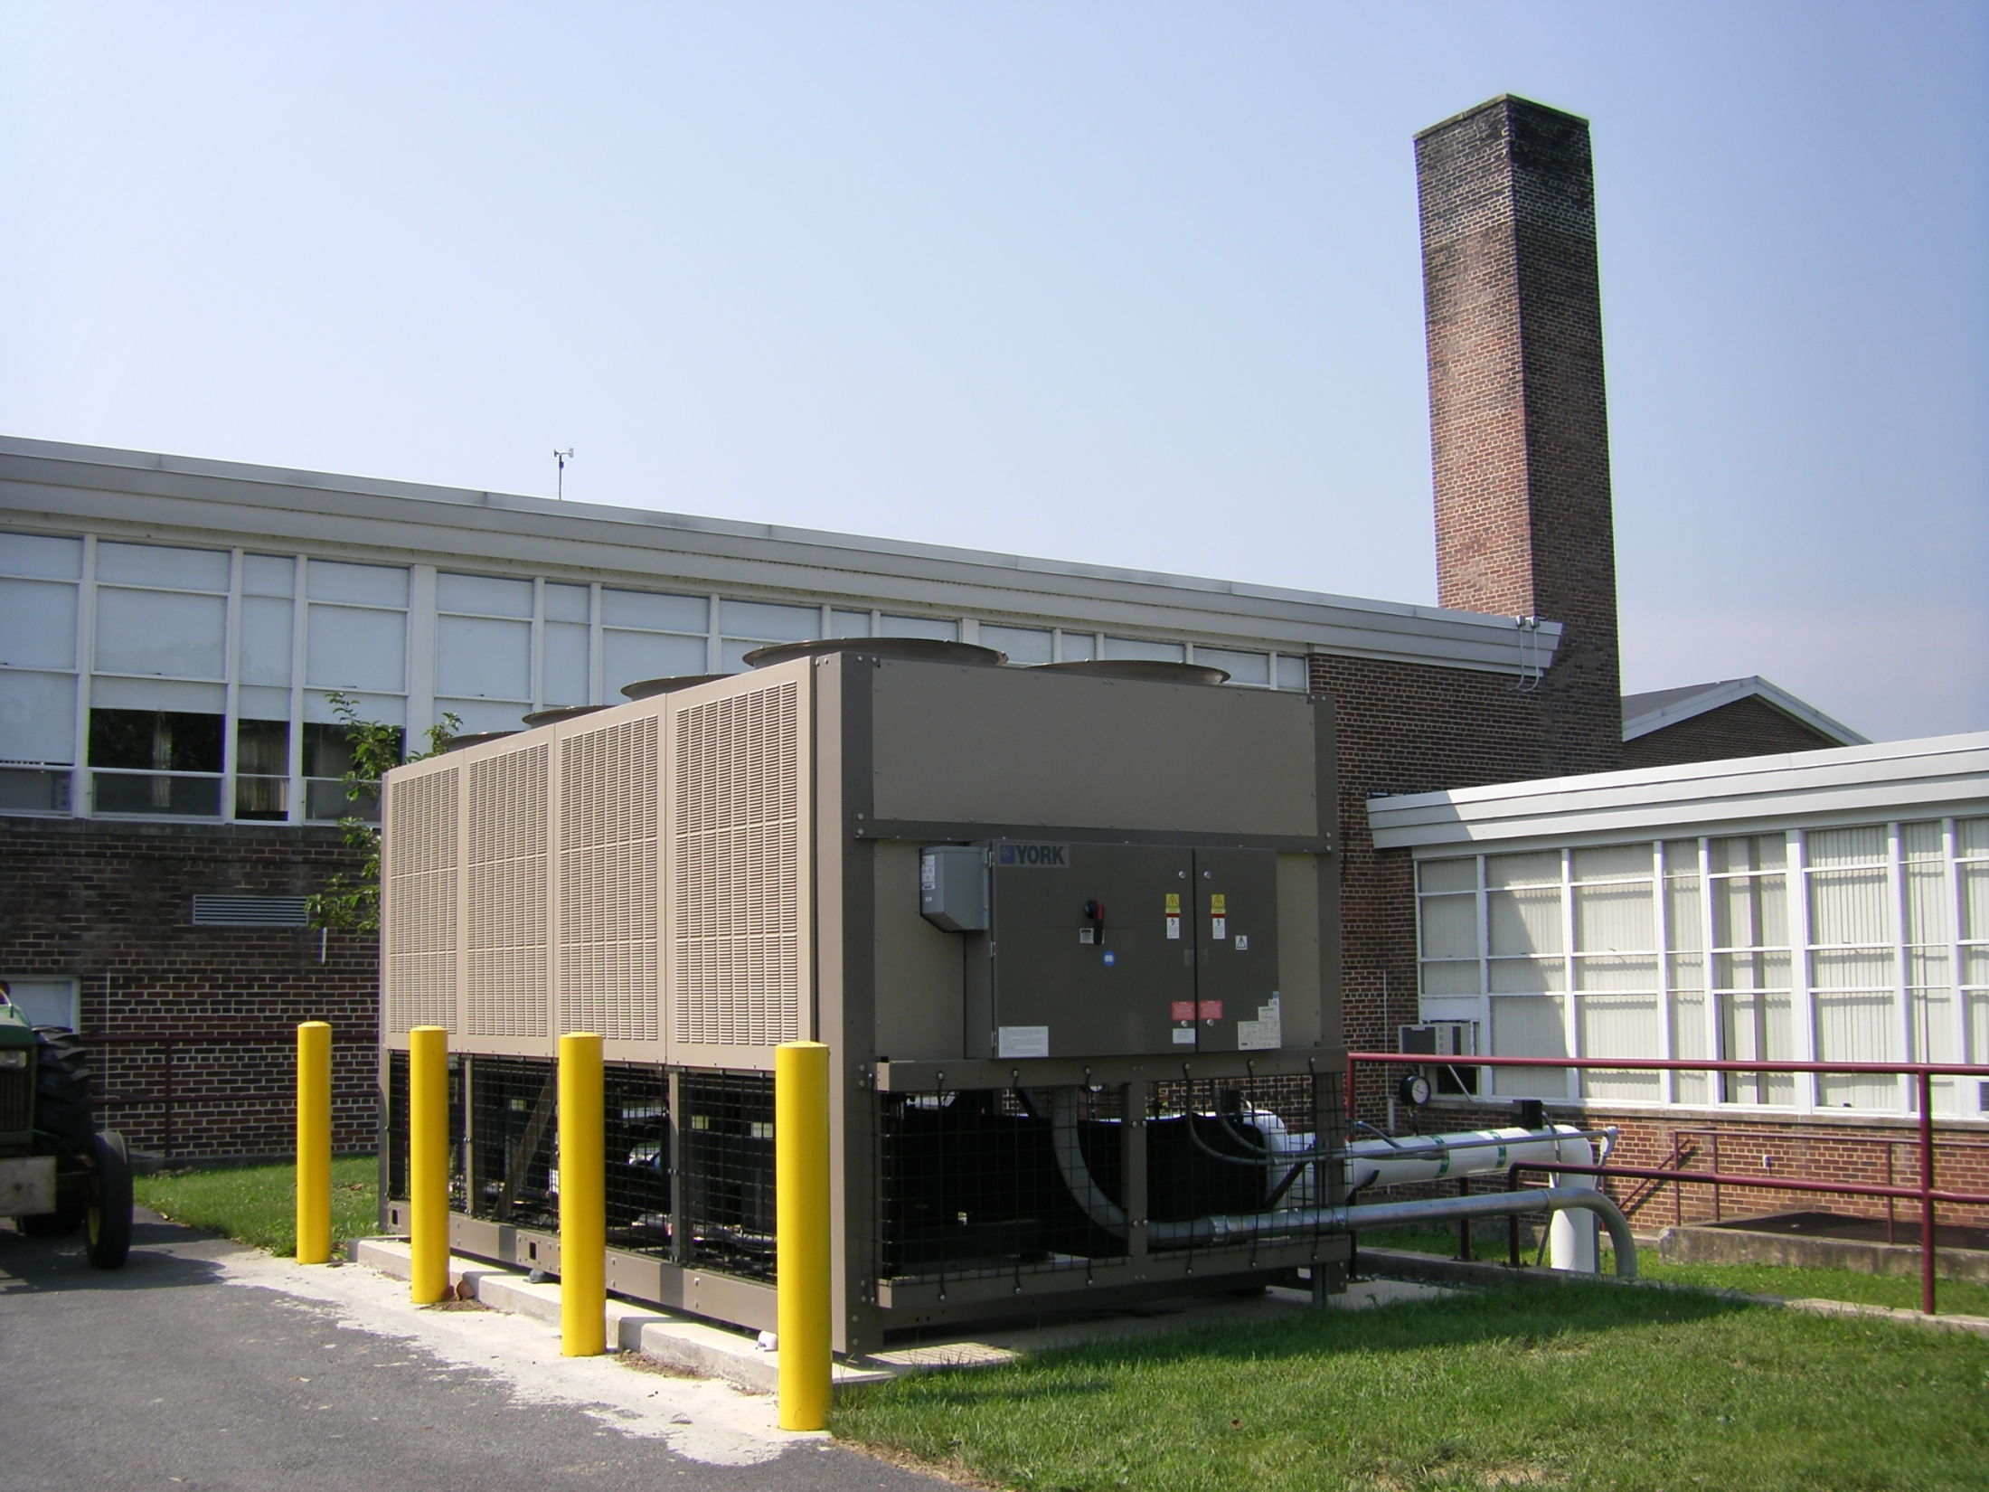
Chiller serving
2-pipe FCU’s

Slide 89
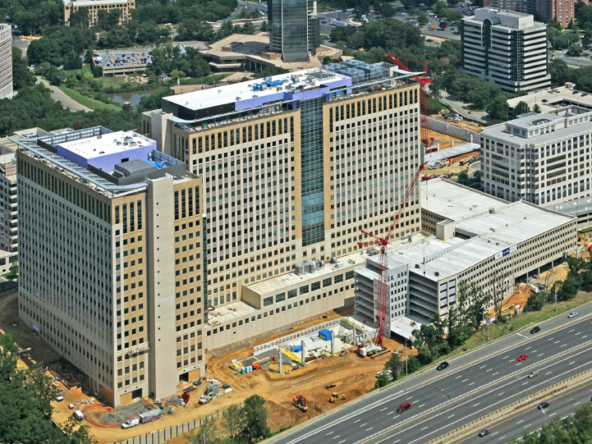
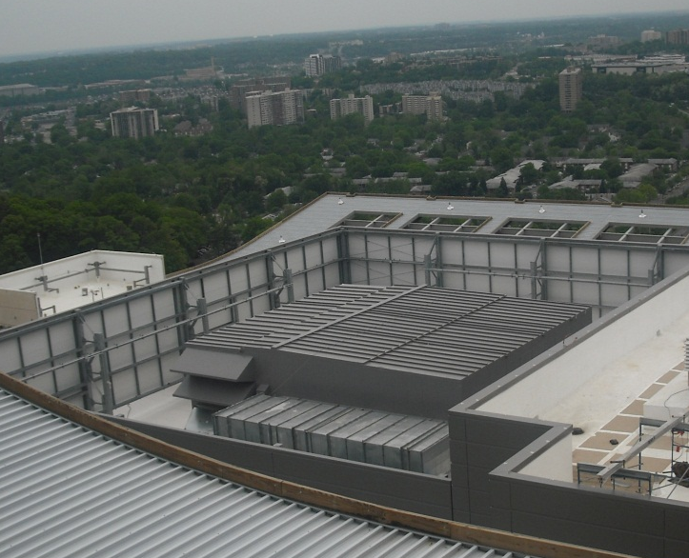
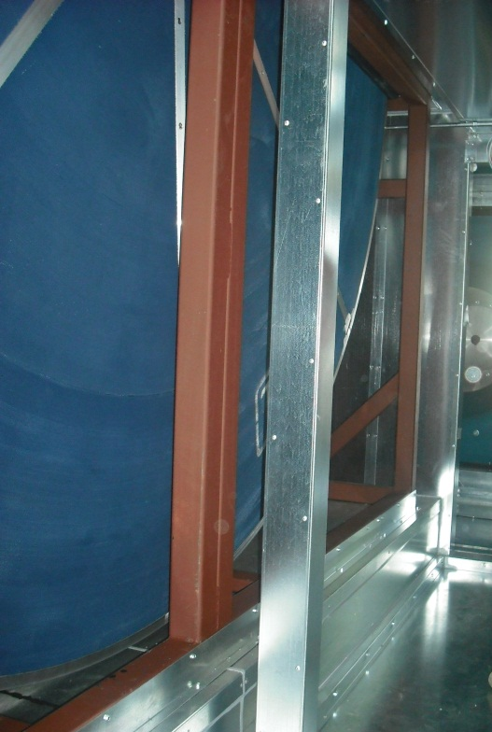
4 @ 85,000 cfm DOAS Units
(~0.22 cfm/ft²)
  Two Office Towers, Alexandria, VA
  17 Tenant Floors
  1,300,000 ft² tenant space

Slide 90
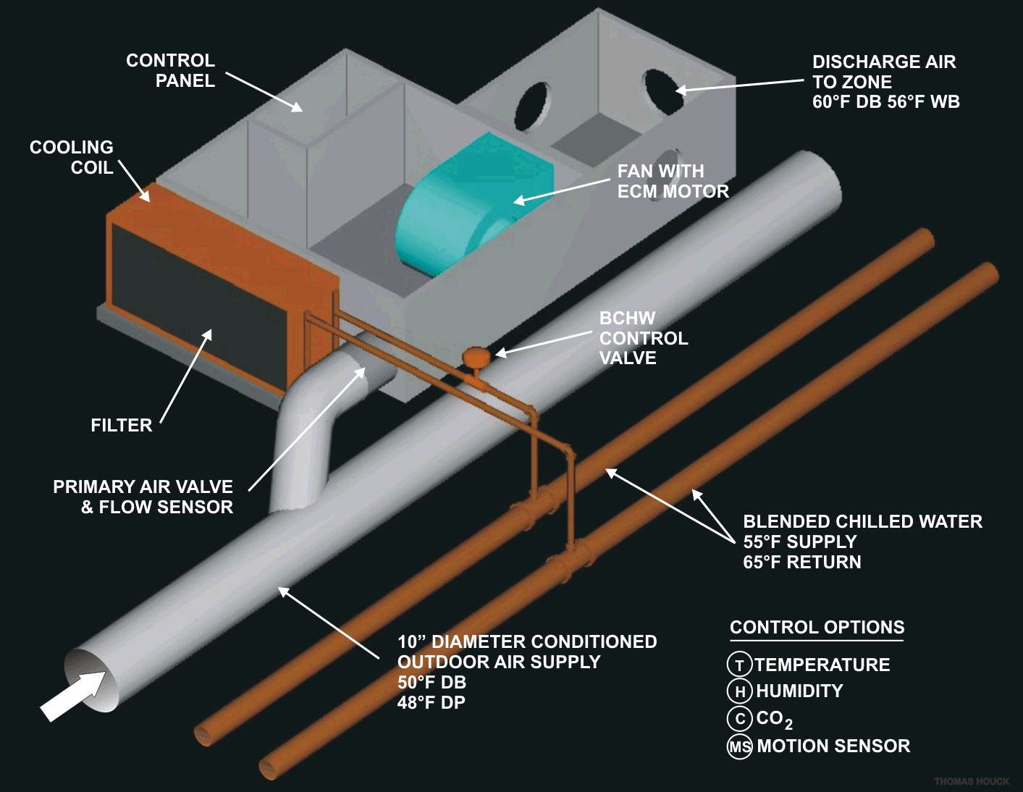
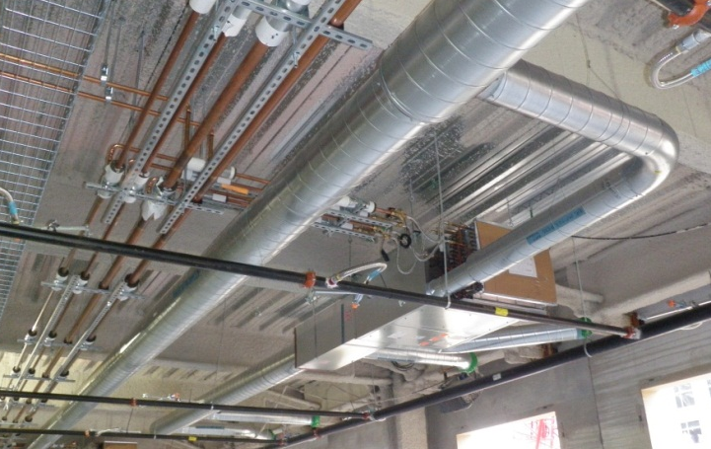

Slide 91
Conclusion
DOAS offers the following benefits:
  Assured ventilation performance
  Excellent IEQ
  Low energy use compared to all-air systems
  Much simpler controls compared to VAV
  Competitive first-cost
Congratulations to those of you already designing/building/using DOAS !!!!!!!!

Slide 92
Questions

Slide 94
Air Side Economizer Lost: Implications!
This a frequent question, coupled with the realization that without full air side economizer, the chiller may run many more hours in the winter than owners and operators would expect based on their prior experiences.
The following slides will address this issue.
For more details, please check the link:
http://doas-radiant.psu.edu/IAQ_Econ_Pt1_Pt2.pdf

Slide 95
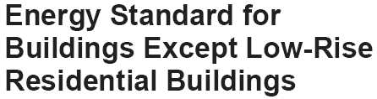
100% Air Side Economizer Lost!
6.5.1 Air (100% OA) or Water (via a cooling tower) Economizers: a prescriptive requirement
11.1.1 Energy Cost Budget Method, an alternative to the prescriptive provisions. It may be employed for evaluating the compliance of all proposed designs. Requires an energy analysis.

Slide 96
Air Side VAV Econ. Performance Vs. DOAS
An example, assuming:
Internally dominated cooling load building. Fully occupied 6 days per week, from 6 am to 7 pm (13 hours per day, 4,056 hours per year).
100,000 cfm design supply air flow rate at 55°F
Minimum ventilation air requirement: 20,000 cfm
In the economizer mode, the OA flow can modulate between 20,000 cfm and 100,000 cfm
Therefore, the only variability in chiller energy consumption/demand is the economizer control and the geographic location

Slide 97
Objective
Show that DOAS w/o economizer uses less energy than VAV with economizer
Assumes:
0.7 kW/ton cooling
Fan eff. 70%: Motor eff. 90%
Electricity: $0.08/kWh
AHU internal ΔP=3”, External ΔP=4”

Slide 98
Min OA Region if Enthalpy Ctl, or 100% OA if DBT Ctl:
691 hrs, Miami, FL
419 hrs, Columbus OH.
193 hrs, Int’l Falls, MN.
100% OA Region:
523 hrs, Miami, FL
1058 hrs, Columbus OH.
886 hrs, Int’l Falls, MN.
¹⁹⁶
¹⁶⁸
Modulating OA Region:
76 hrs, Miami, FL
1894 hrs, Columbus OH.
2771 hrs, Int’l Falls, MN.
OA Design:
Miami, 311 T
Columbus, 290 T
Int’l Falls, 271 T
¹⁴⁰
¹¹²
Load if 100% OA, 560 T
by design or malfunction
⁸⁴
Min OA Region:
2766 hrs, Miami, FL
685 hrs, Columbus, OH.
206 hrs, Int’l Falls, MN.
^{Humidity ratio (grains/lb)}
⁵⁶
²⁸

Slide 99
Economizers frequently experience malfunctioning problems, including stuck or improperly operating dampers. Malfunctions can be minimized as follows:
Quality components must be selected and properly maintained.
Economizer dampers must be tested twice annually before entering each cooling and heating season.
Item 2 is rarely done because of operational priorities and the frequent inaccessibility of the hardware.

Slide 100
Industry Advice when Economizers Experience Repeated Problems
Ref: http://www.uppco.com/business/eba_8.aspx
The electric utilities recommend, in order to place a lid on high demand, “locking the economizer in the minimum outside air position if an economizer repeatedly fails, and it is prohibitively expensive to repair it.
Although the potential benefits of the economizer’s energy savings are lost, it is a certain hedge against it becoming a significant energy/demand waster.”

Slide 101
h Econ Savings over DOAS:
Miami, $2,184
Columbus, $16,000
Int’l Falls, $18,760
100% OA Region if DBT Ctl. vs., Min OA if Enthalpy Ctl: (DOAS)
234 vs. 150 kTH, Miami, FL
122 vs. 87 kTH, Columbus OH.
53 vs. 40 kTH, Int’l Falls, MN.
¹⁹⁶
Fan Op. Cost
VAV fan energy: $41,500
DOAS fan energy: $8,000
DOAS Fan Savings: $33,500,
or 2-15 times Econ savings.
¹⁶⁸
Min OA Region:
Economizer does not reduce the TH’s in this region compared to DOAS.
¹⁴⁰
Modul’g OA Region vs. DOAS:
0 vs. 10 kTH, Miami, FL
0 vs. 209 kTH, Columbus OH.
0 vs. 266 kTH, Int’l Falls, MN.
¹¹²
⁸⁴
^{Humidity ratio (grains/lb)}
100% OA Region vs. DOAS:
59 vs. 88 kTH, Miami, FL
94 vs. 171 kTH, Columbus
75 vs. 144 kTH, Int’l Falls
⁵⁶
²⁸

Slide 102
Economizer Summary
Using water economizer with DOAS-hydronic systems is a good idea, and can save mechanical cooling energy.
It is recommended for applications employing water cooled chillers.
However the DOAS-hydronic systems should not need WSFC to comply with the Energy Cost Budget Method of Std. 90.1.
That’s good, because many projects are too small for cooling towers, but are excellent candidates for DOAS-hydronic.

Slide 103
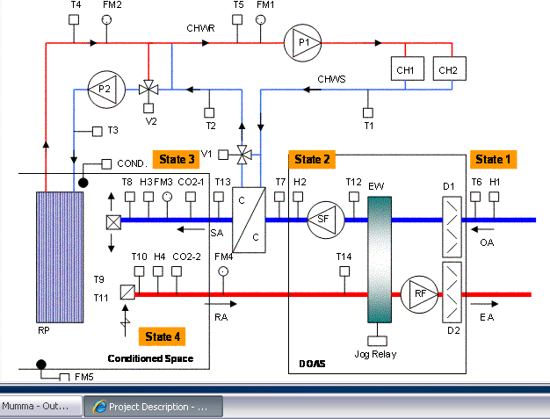

Slide 104
Maximize DOAS free cooling, w/ proper EW control, when hydronic terminal equipment used.

Slide 105
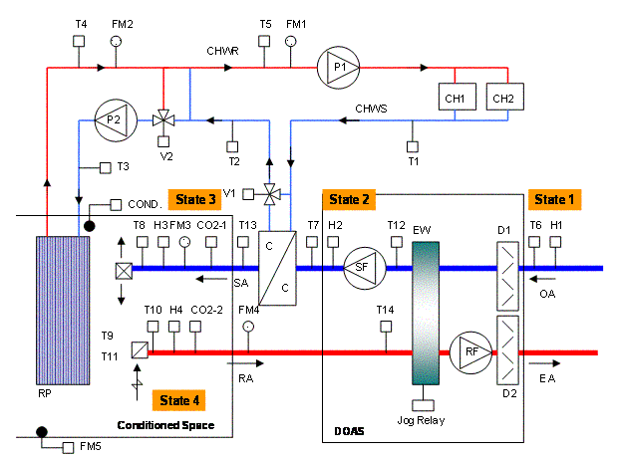
Tempering OA without the loss of air side economizer!
DOAS Unit
Parallel sen. unit

Slide 106
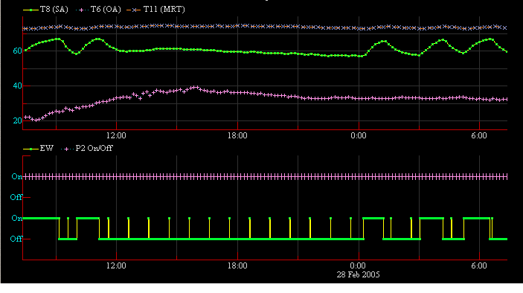
Free cooling performance data
Space T (MRT)
SA DBT
OA DBT
Panel Pump (P2) On
EW on/off
Midnight

Slide 107
2. EW wheel frost control to minimize energy use.

Slide 108
EAH
RA
5
3
4
Space
OA
EAH
PH
CC
Process line cuts sat curve:
cond. & frost
OA
New process line tangent to sat. curve, with PH.
PH
New process line with EAH

Slide 109
Another EW frost prevention control:
Reduced wheel speed.
Very negative capacity consequences when heat recovery most needed (at -10F, wheel speed drops to 2 rpm to prevent frosting), capacity reduced by >40%.
Suggest avoiding this approach to frost control.

Slide 110
3. Control to minimize the use of terminal reheat.

Slide 111
Limit terminal reheat energy use
Reheat of minimum OA is permitted by Std. 90.1. Very common in VAV systems.
Two methods used w/ DOAS to limit terminal reheat for time varying occupancy:
  DOAS SA DBT elevated to ~70F. Generally wastes energy and increases first cost for the parallel terminal sensible cooling equip. (not recommended!)
  Best way to achieve limited terminal reheat is DCV. (saves H/C energy, fan energy, TER eff)
    CO₂ based
    Occupancy sensors

Slide 112
4. Pressurization control.

Slide 113
Building Pressurization Control
Pressurization vs. infiltration as a concept.
outside
envelope
inside
Pressure-positive
Pressure-neutral
Infiltration Air
flow direction

Slide 114
Building Pressurization Control
Pressurization vs. exfiltration as a concept.
outside
envelope
inside
Pressure-neutral
Pressure-positive
Exfiltration Air flow direction

Slide 115
Building Pressurization Control
Active Pressurization Control
outside
envelope
inside
Pressure:
P₂=P₁+0.03” WG
Controlled variable, ΔP
Pressure: P₁
Air flow direction, 1,000 cfm

Slide 116
Building Pressurization Control
Controlled flow pressuration.
What happens to depen-
dent variable P₂ if wind
vel. increase P₁, w/
controlled flow?
(pressurization flow no
more than 1,000 cfm)?
outside
envelope
inside
Pressure: P₁
Pressure: P₂ > P₁
Controlled variable:
flow, not P₂
Air flow direction, 1,000 cfm

Slide 117
Unbalanced flow @ TER if pressurization is ½ ACH, based upon Std. 62.1
i.e. means
RA = 70% SA:
Leads
to unbalanced flow at
DOAS unit

Slide 118
Impact of unbalanced flow on EW
h₄
RA, m_{RA}, h₃
OA, m_{OA}, h₁
h₂
ε =(h₄-h₃)/(h₁-h₃), for balanced or press’n unbalanced flow
ε_{app}=(h₁-h₂)/(h₁-h₃)=ε *m_{RA}/m_{OA} Note: ε =ε_{app} w/ bal. flow
ε_{app} (apparent effectiveness) accounts for unbalanced flow.
ε_{app} ≠ net effectiveness (net ε, AHRI 1060 rating parameter)
net ε accounts for leakage between the RA (exh.) and OA

Slide 119
100% 83% 67% 50% 33%
energy recovery, %
effectiveness, ε
app. effectiveness, ε_{app}
Hi
Low

Slide 121
Discuss flow based pressurization control

Slide 122
Conclusions,
Fortunately, DOAS controls are simpler than VAV control systems.
Unfortunately, they require a different paradigm—something the industry is just coming up to speed on.
A properly designed and controlled DOAS will reduce:
  Energy use/demand,
  First cost,
  Humidity problems and related IEQ issues
  Ventilation compliance uncertainty.

