Slide 1

Active Chilled Beams (ACB):
Rising Contender or
Passing Fad
2014 Conference
Presentation
Stanley A. Mumma, Ph.D., P.E.
Prof. Emeritus, Architectural Engineering
Penn State University, Univ. Park, PA
sam11@psu.edu

Slide 2
Introduction
History of Chilled Beams
Basic ACB defined
ACB enhancements available
Primary air to the ACB
Emergence of ACB technology in the USA
Primary errors observed in US applications.
Conclusion
Presentation outline

Slide 3
Introduction
Technical expertise represented in this session, Eng., contractors, owners, service, investor, manuf.
Experience with ACBs represented in this session
Experience with DOAS represented in this session
Service areas west of the Rocky Mountains.

Slide 4
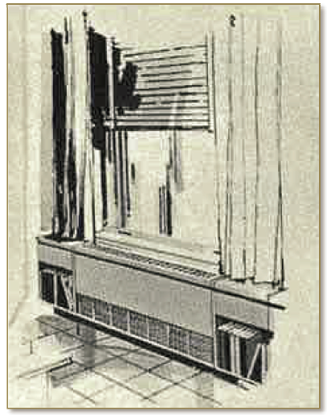
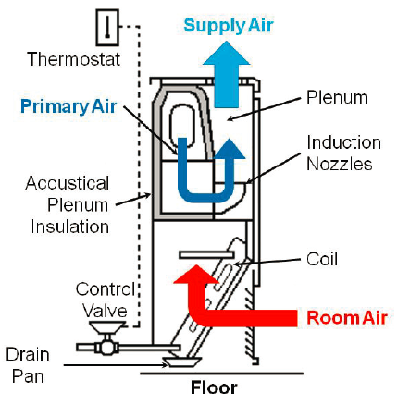
History of ACBs
Carrier induction boxes (IB)
The perimeter induction terminal system was the
system of choice for 1930’s to 1950’s mid-town high-rise office towers.

Slide 5
History of ACBs
IBs fell into disfavor and were replaced during the 1950’s with fan coil units in the USA.
Negative aspects of the perimeter wall induction terminal:
  Excessive fan energy associated with the high pressure primary air requirements of the nozzles (up to 2 in. wg) and
  Rezoning difficulties did not meet the needs of new building occupancy profiles.
  So the perimeter induction terminal system became a system of the past and was replaced largely by fan coil units.

Slide 6
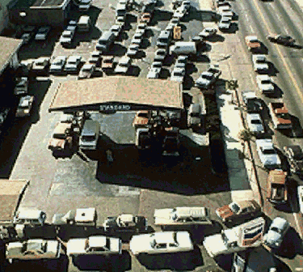
History of ACBs
Impact of the October 1973 Middle East Oil Embargo on HVAC systems:
  Europe, focus was concentrated on chilled ceilings and beams. Their major changes from the US IB approach was,
    Ceiling vs window placement
    Much more efficient nozzles, capable of high induction with 80% lower primary air pressures—reducing fan energy and noise (< NC 30).
  USA, focus shifted from constant volume systems to VAV.

Slide 7
Basic ACB defined
A chilled beam is an air distribution device with an integral coil that may be installed within a space in order to provide sensible cooling and heating.
ACBs are those that have ductwork supplied to them providing a specific amount of primary air to the pressurized plenum within the device to be discharged through induction nozzles, mix with entrained air, and ventilate the room.

Slide 8
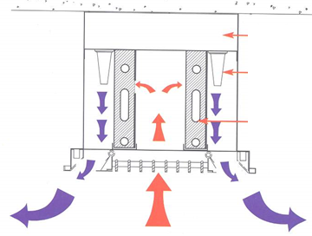
Basic ACB defined
Main elements
  Air box
  Induction nozzles
  Sen. Coil
  Room air grill
  M.A. Disc louver
  Condensate pan

Slide 9
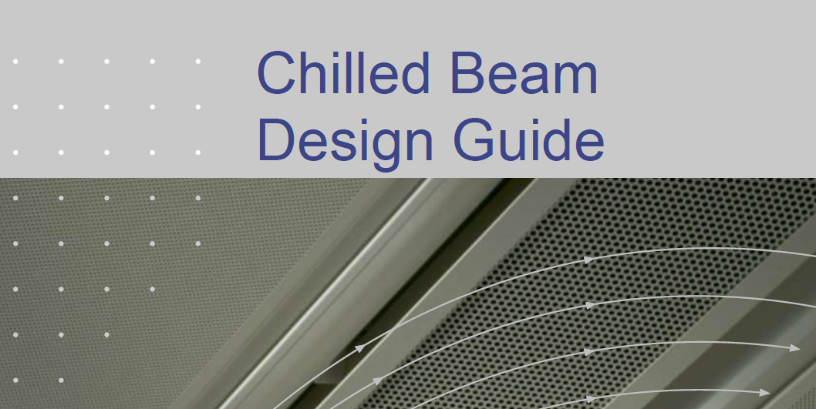
Basic ACB defined
Manuf. Lit. has rich design information including:
Control
  Air flow
  Water flow
  Condensation

Slide 10
ACB enhancements available:
Mounting configurations

Slide 11
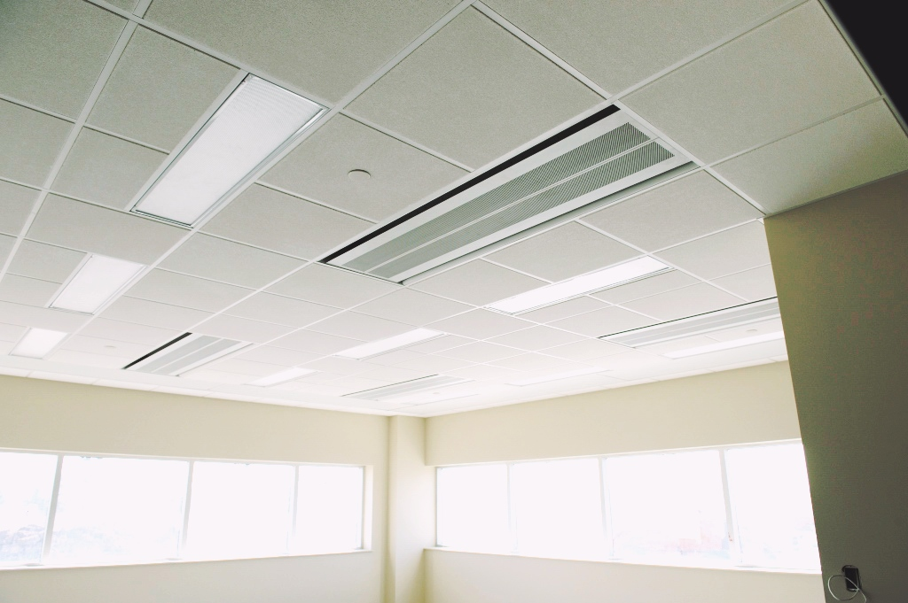
Open Office Area

Slide 12
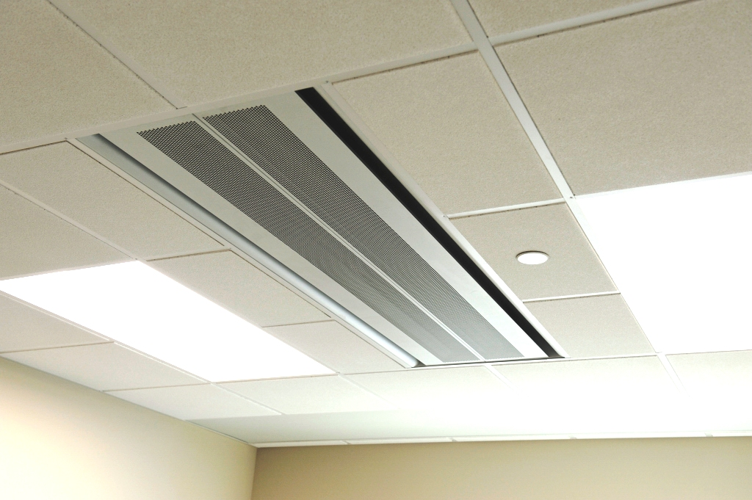
Individual Office Area

Slide 13
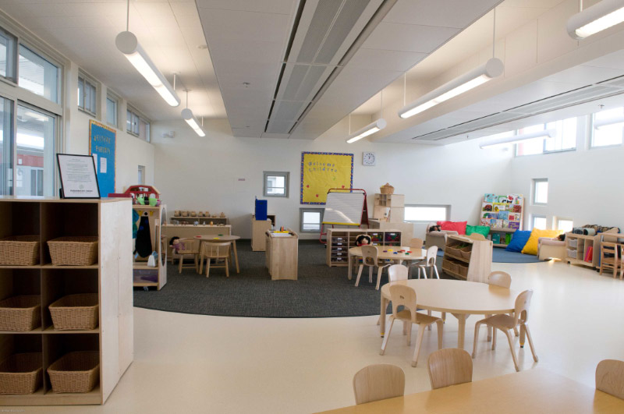
Child Care Center

Slide 14
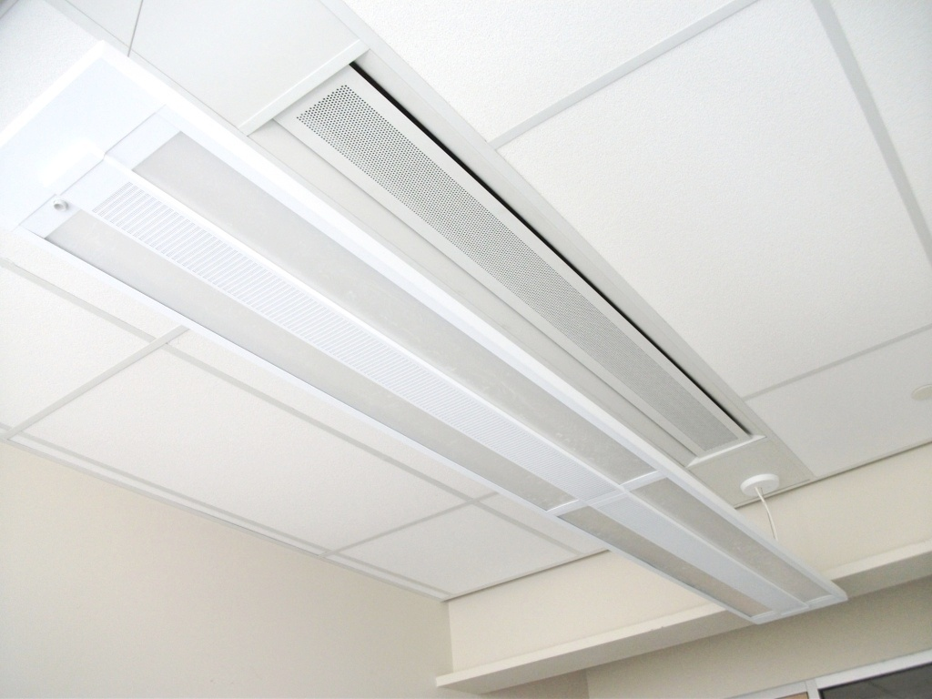
Beam above pendant light

Slide 15
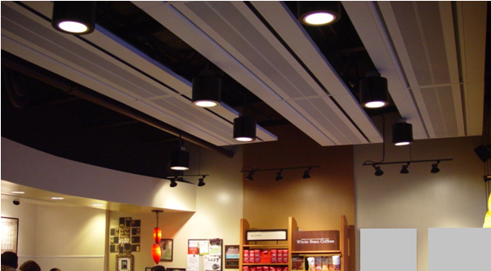
Coffee Shop

Slide 16
ACB enhancements available:
Multi-Service Beams:
services can include,
  heating & cooling,
  fresh air supply,
  uplighting, downlighting, emergency lighting, and fully addressable lighting solutions etc.
  ATC sensors, control valves & condensation detectors
  fire alarms and sprinkler heads
  acoustic insulation
  pipework, ductwork & compartmental trunking

Slide 17
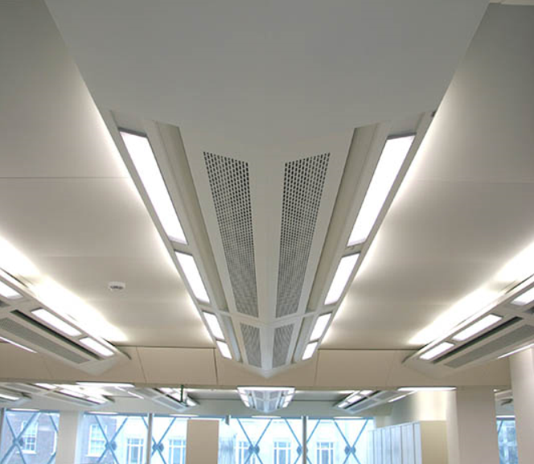
ACB enhancements available:
Multi-Service Beam

Slide 18
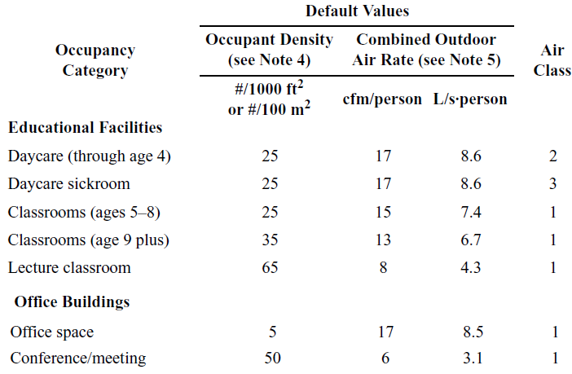
Primary air to the ACB
Functions:
  Meet each spaces minimum ventilation requirements with certainty using no centrally recirculated air, which should not vary much from 18-20 cfm/person combined floor and occupant components.
~45F DPT
~36F DPT
~25F DPT

Slide 19
Unit to condition Primary ACB ventilation air
PH
CC
Pressurization
1
2
3
4
OA
ACB
RA
5
Fan
Space
TER
SA DBT, DPT to decouple space loads?

Slide 20
EW
RA
5
1
2
3
4
Space
2
OA
PH
CC
Hot & humid OA condition
3
5
Q_{L}
4
Q_{S}

Slide 22
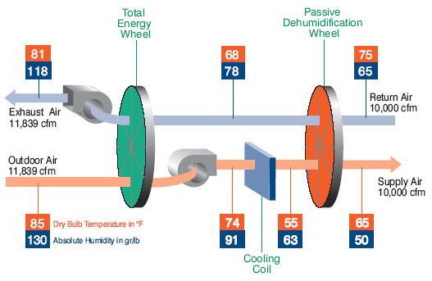
Alternate Unit to condition
Primary ACB ventilation air

Slide 23
Primary air to the ACB
Functions:
  Remove the entire space Latent Load (generally requires low SA DPTs—45-50F)

Slide 24

Primary air to the ACB
Functions:
  Keep the space DPT low enough that the ACB coils can remove the design space sensible loads without:

Slide 25
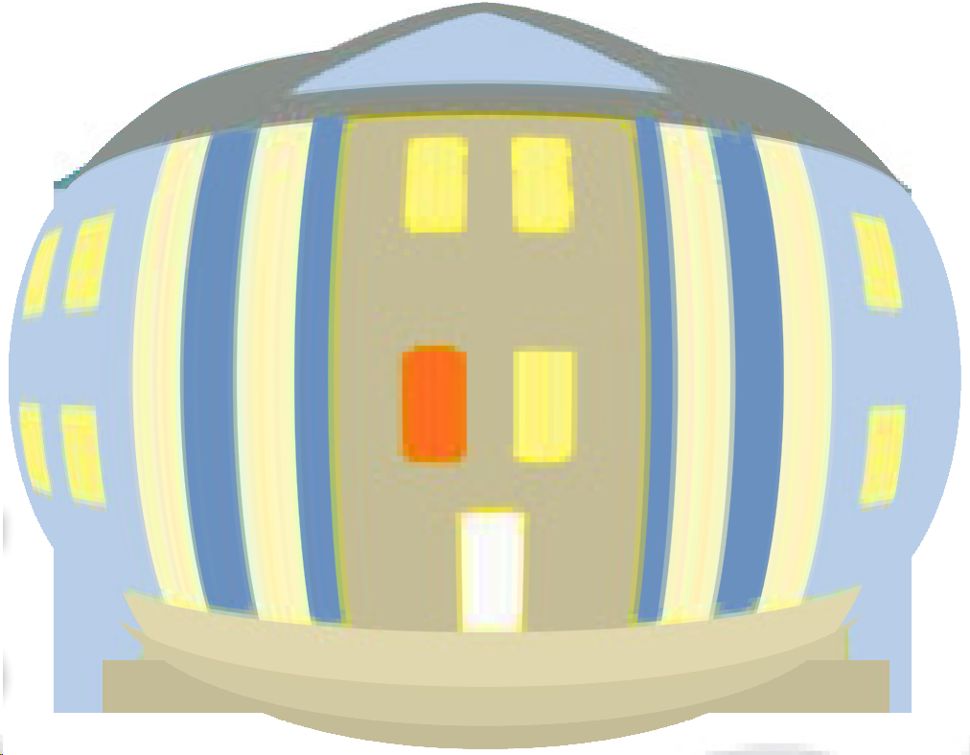
Primary air to the ACB
Functions:
  Pressurize the building

Slide 26
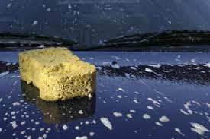
Primary air to the ACB
Functions:
  Source of reserve latent cooling capacity

Slide 27
Primary air to the ACB
Functions:
  Vehicle to induce room air across the ACB sensible cooling coils

Slide 28
Primary air to the ACB
Functions:
  Provide a part of the space sensible cooling

Slide 29
Primary air to the ACB
Functions:
  DCV is effective at minimizing overcooling with low primary air temperatures in spaces with highly variable occupancy patterns (a variable volume supply of primary air)

Slide 30
Primary air to the ACB
Another name for systems employing such primary air along with ACBs: Dedicated Outdoor Air Systems (DOAS).
Link: http://doas-radiant.psu.edu
PH
CC
Pressurization
1
2
3
4
OA
ACB
RA
5
Fan
Space
TER
SA DBT, DPT to decouple space loads?

Slide 31
Emergence of ACB technology in the USA
Proper ACB system design advantages over all-air VAV system designs
  Fan energy
  Chiller op cost
  Comfort
  Enhanced IEQ
  Reduced Op cost
  Reduced First cost Low maintenance costs (No moving parts)
  Cooling Capacity: ~ 32 – 125 Btuh/ft²

Slide 32

Emergence of ACB technology in the USA
First major systems
ACB availability domestically and internationally
Existence of an ACB association of manufacturers
Passive Chilled Beams

Slide 33
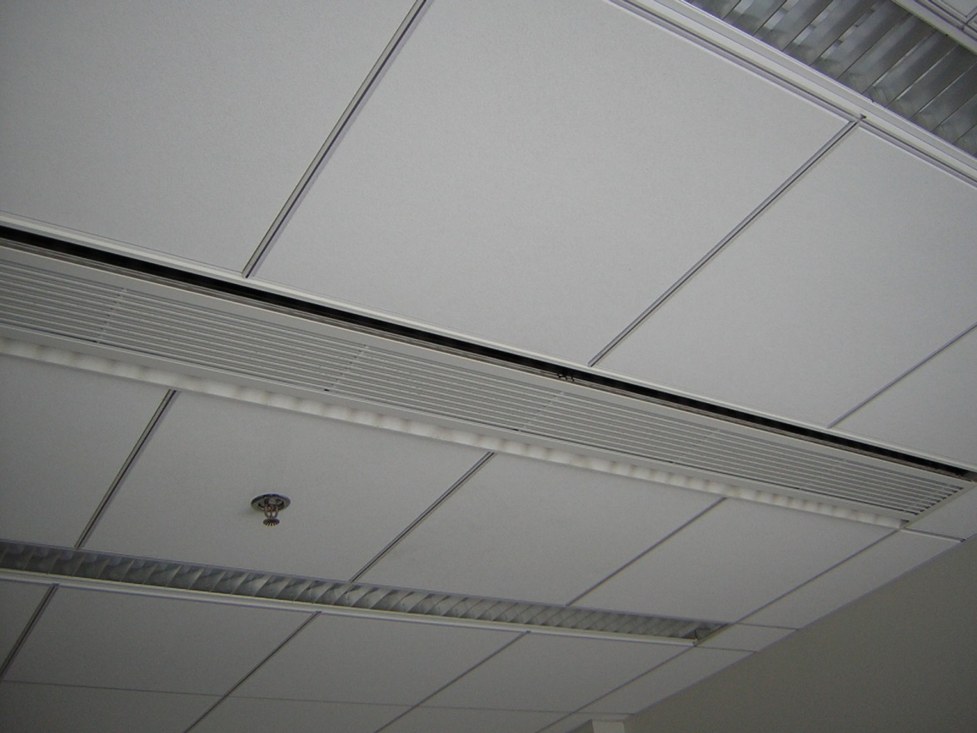
Emergence of ACB technology in the USA, Cons

Slide 34
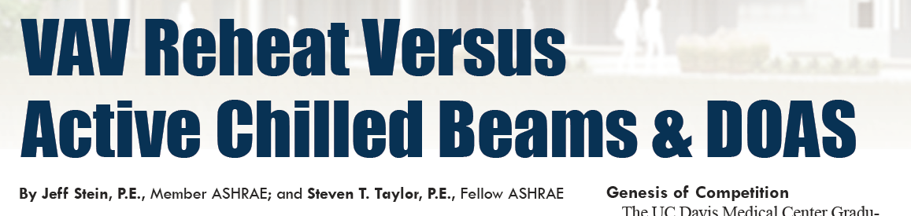
Emergence of ACB technology in the USA, Cons
ASHRAE Journal May 2013 feature article

Slide 35
Emergence of ACB technology in the USA, Cons
ASHRAE Journal May 2013 feature article
conclusion,
the VAV reheat system had:
  the lowest first and energy costs
  many of the supposed advantages of ACB+DOAS relative to VAVR turned out to be largely overstated, such as:
    improved indoor air quality and
    a lower floor/floor height.

Slide 36
Emergence of ACB technology in the USA, Cons
ASHRAE Journal May 2013 article ERRORS:
  The 33,900 cfm of ventilation air used in the design exceeds by 250% the 13, 574 cfm minimum required by ASHRAE Std. 62.1.
  At 24 cfm/p it is difficult to achieve the 49.4F DPT with the 45 F campus CHWS, and even more difficult when supplying 17 cfm/p at 46.7F SA DPT.

Slide 37
Emergence of ACB technology in the USA, Cons
ASHRAE Journal May 2013 article ERRORS:
  The highly variable occupancy classrooms should be equipped with DCV. As a result, the DOAS SA flow rate would vary with occupancy, constrained by a space DBT override, thus operate much like a conventional VAV system.
  The office design SA flow is 41% greater than required by 62.1. Providing the extra air adds significantly to the first and operating cost, particularly since all free cooling is eradicated by reheating to 63F.

Slide 38
Emergence of ACB technology in the USA, Cons
ASHRAE Journal May 2013 article ERRORS:
  Reheating air from below 50F to 63F in an effort to minimize terminal reheat is an absolute energy and first cost travesty. Reheating that air wastes 145,000 ton-hours of cooling plus the reheat energy, and this is just the tip of the problem. Minimal if any reheat would be required in the classrooms employing DCV, and it would be most difficult to overcool the office areas with 0.09 cfm/ft² of SA at 56F.
  http://doas-radiant.psu.edu/Mumma_Observations_Taylor_ASHRAE_May_2013_article.pdf
Article conclusion wrong when correct design/application used!

Slide 39
Primary errors observed in US applications.
SA DBT near 70F rather than 48-50F
SA DPT near 55F which requires a much higher SA flow rate to completely remove the entire space latent load.
SA is a mix of 100% OA and centrally recirculated air

Slide 40

30’ X 40’ office space w/ 6 occupants
Assumed Sensible Loads:
  At 0.6 cfm/ft², (i.e. internal)
  Q_{S} = 1.08*0.6*1,200*(75-55)
  Q_{S} = 15,550 Btu/hr
  At 1.0 cfm/ft², (i.e. external)
  Q_{S} = 1.08*1.0*1,200*(75-55)
  Q_{S} = 25,920 Btu/hr

Slide 41
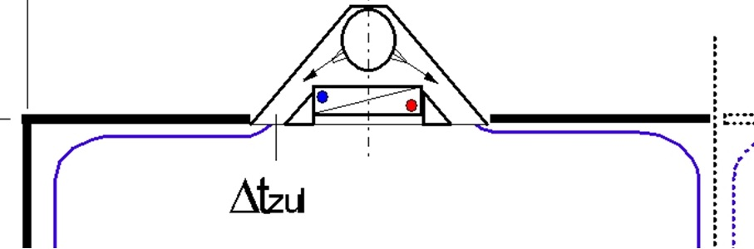
Manufacturers selection software
ACB configuration used

Slide 42
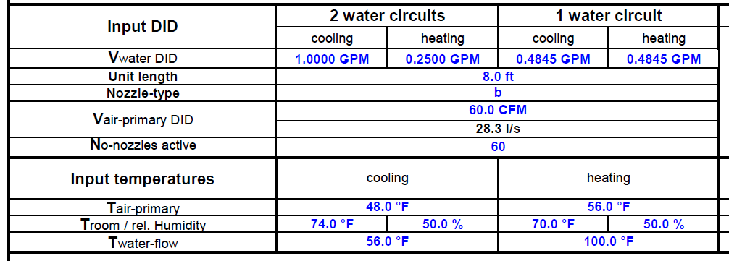
Manufacturers selection software

Slide 43
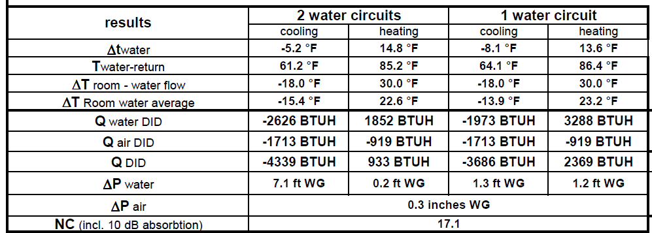
Manufacturers selection software
Not all ACB’s perform the same

Slide 44
DOAS + Local Recirc. for 15,550 Btu/hr. Sen. Space load
1,175 air
2,625 Coil
120 cfm DOAS, 48 F
Q_{S} = 4,339 Btu/hr Ea
Q_{S} = 3,800 Btu/hr Ea
8’
Sen CC
1,714 air
2,625 Coil
120 cfm 56 F
FCU Q_{S} = 2,335 Btu/hr

Slide 45
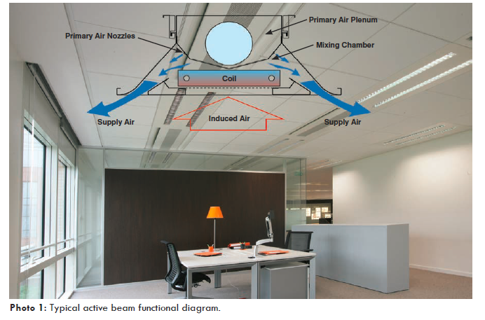
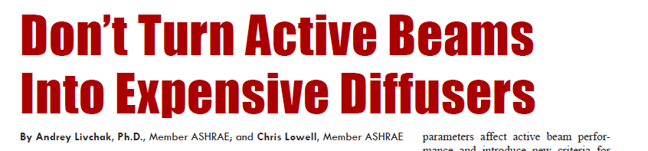

Slide 46
A DOAS set of Thermodynamic State Points
ASHRAE 0.4% Dehumidification Design Cond.: Ft. Lauderdale
120 cfm, 84.7F,
152 gr/lb, 44.5 Btu/lb
48F, 49 gr/lb,
19.17 Btu/lb
Coil load
Q_{T} = 4.5*120*(44.5-19.17)
Q_{T} = 13,680 Btu/hr
Space latent load met
based on 74F, 50%, 63 gr/lb
Q_{L}= 0.68*120*(63-49)
Q_{L}= 1,140 Btu/hr or 190 Btu/hr/p
OA load
Q_{OA} = 13,680-(1,140+3,370)
Q_{OA} = 9,170 Btu/hr
Space sensible load met
Q_{S}= 1.08*120*(74-48)
Q_{S}= 3,370 Btu/hr

Slide 47
DOAS + Local Recirc. for 25,920 Btu/hr. Sen. Space load
2,161 air
3,979 Coil
110 cfm DOAS, 48 F
Q_{S} = 6,140 Btu/hr Ea
3,138 air
3,979 Coil
Q_{S} = 7,117 Btu/hr
10’
220 cfm
110 cfm
56 F
Q_{S} = 6,420 Btu/hr .

Slide 48
DOAS w/o Local or Central Recirc. for 25,920 Btu/hr. Sen. Space load
2,621 air
3,979 Coil
440 cfm DOAS, 52.6 F
Q_{S} = 6,600 Btu/hr Ea
10’

Slide 49
A DOAS set of Thermodynamic State Points
440 cfm, 84.7F,
152 gr/lb, 44.5 Btu/lb
52.6 F, 59.2 gr/lb,
21.81 Btu/lb
Space latent load met
based on 74F, 50%
Q_{L}= 0.68*440*(63-59.2) Q_{L} = 1,140 Btu/hr
Coil load
Q_{T} = 4.5*440*(44.5-21.81) Q_{T} = 44,930 Btu/hr
OA load
Q_{OA} = 44,930-(1,140+10,170)
Q_{OA} = 33,620 Btu/hr
Space sensible load met
Q_{S}= 1.08*440*(74-52.6)
Q_{S}= 10,170 Btu/hr

Slide 50
DOAS w/ Central Recirc. for 25,920 Btu/hr. Sen. Space load
MA: 110 cfm OA &
330 cfm Recirc., 52.6 F
Q_{S} = 6,600 Btu/hr Ea
10’

Slide 51
A Mixed Air set of Thermodynamic State Points
440 cfm, 76.7F,
85.45 gr/lb,
31.78 Btu/lb
330 cfm, 74F,
63 gr/lb, 27.53 Btu/lb
110 cfm, 84.7F, 152 gr/lb,
44.5 Btu/lb
52.6 F, 59.2 gr/lb,
21.81 Btu/lb
Coil load
Q_{T} = 4.5*440*(31.78-21.81) Q_{T} = 19,740 Btu/hr
Space latent load
based on 74F, 50%
Q_{L}= 0.68*440*(63-59.2) Q_{L} = 1,140 Btu/hr
Q_{OA} = 8,430 Btu/hr (110 cfm)

Slide 52
DOAS + Local Recirc. for 25,920 Btu/hr. Sen. Space load
110 cfm DOAS, 48 F
Q_{S} = 4,700 Btu/hr Ea (all coil)
Q_{S} = 7,117 Btu/hr
480 cfm Recirc, 74 F

Slide 53
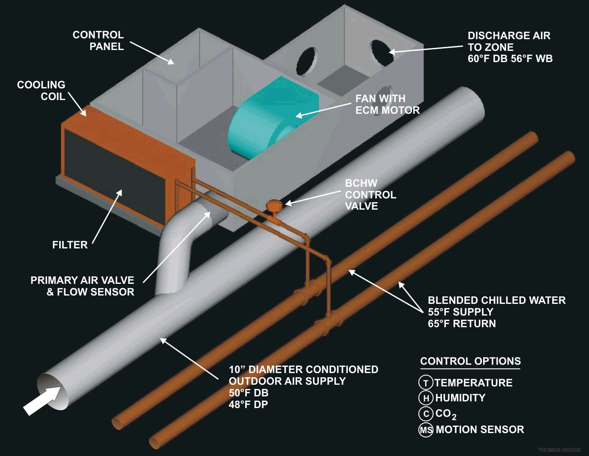
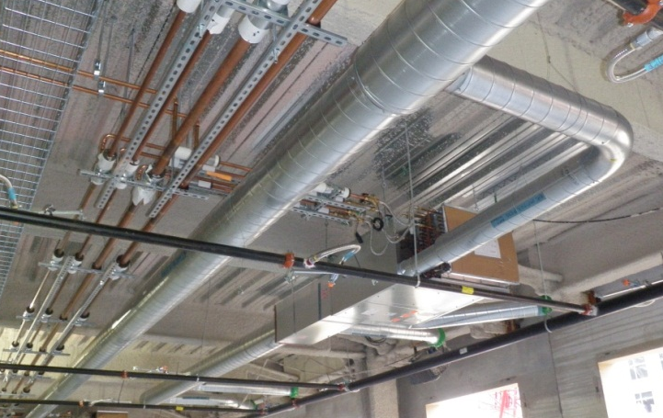
SENSIBLE
Recirc
air
DOAS
Fan Terminal Unit (FTU)

Slide 54
DOAS w/ local rec. for 25,920 Btu/hr. Sen. Space load
110 cfm 48F DOAS
440 cfm 52.6 F primary air
FTU
330 cfm recirc
Q_{S} = 6,600 Btu/hr Ea
10’

Slide 55
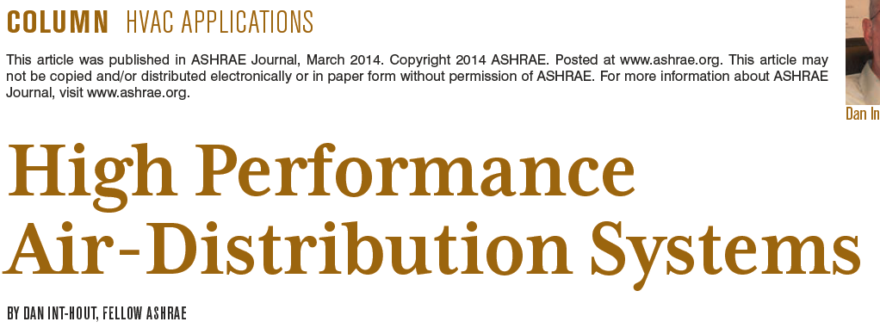
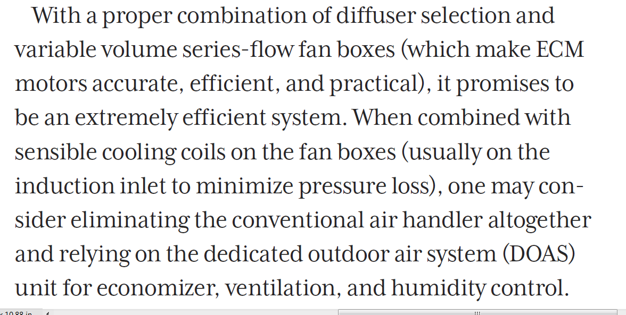
FTU

Slide 56
DOAS w/ local rec. for 25,920 Btu/hr. Sen. Space load
110 cfm 48F DOAS
1,200 cfm 54.5 F SA
FTU
Diffuser
1,090 cfm recirc

Slide 57
Conclusion
Active Chilled Beams (ACB): Rising Contender or Passing Fad?
Already a big success here and abroad.
Future look good when:
  The ACB does not become an expensive diffuser.
  Errors identified are all eliminated.
  Temptation by some to make ACBs the solution for all applications is resisted.
Time still needed to assess the FTU impact on ACB future.

Slide 58
Questions

